Slide 1
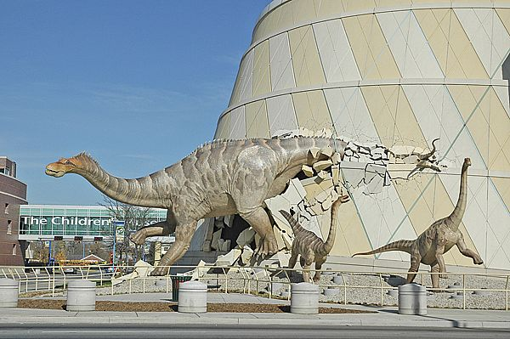
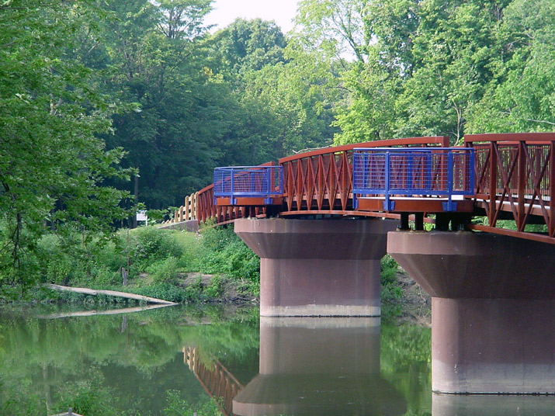
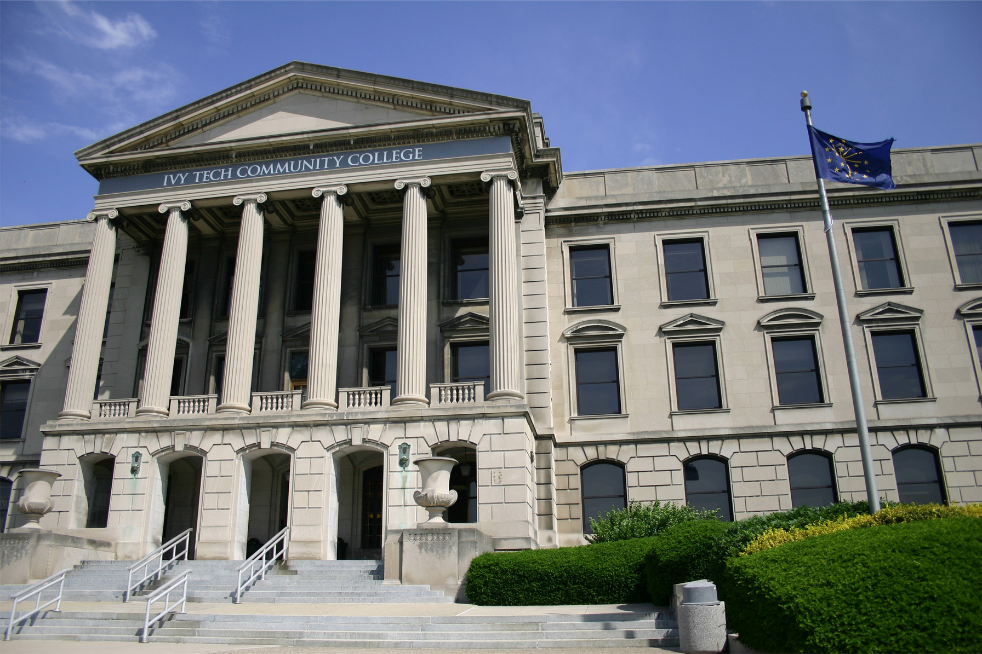
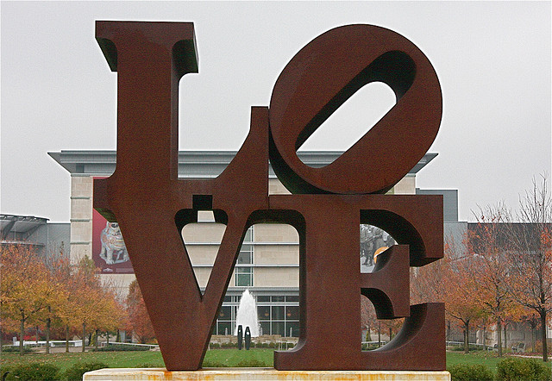
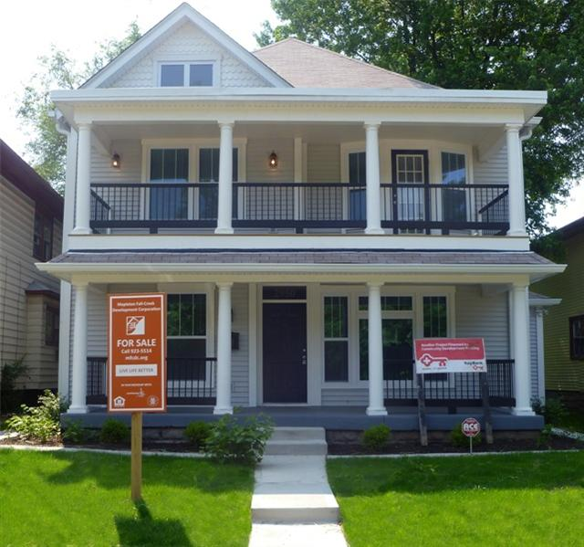
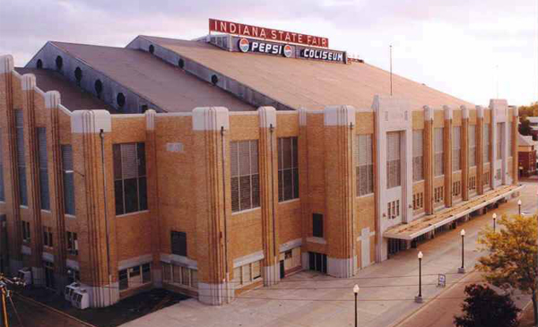
Mapleton-Fall Creek: Connections
Indianapolis, Indiana
January 24, 2014

Slide 2
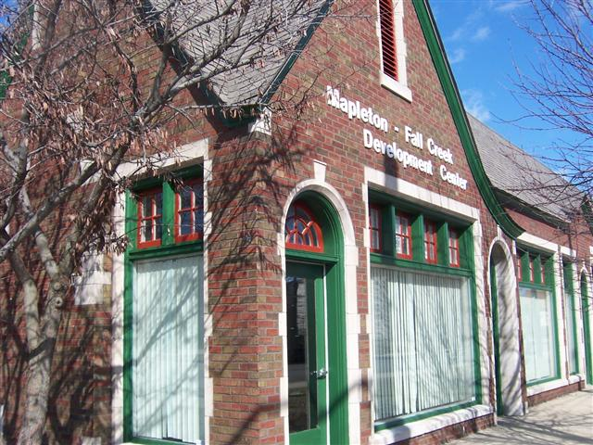
Mapleton Fall Creek Development Corporation
Housing
Economic Development
Parks & Public Spaces
Infrastructure
Sustainability
Community Building
Mission: Connecting neighborhood partners to help, serve, revitalize, stimulate, and invest resources to rebuild an affordable, safe and vital community.
Sources: MFCDC.org
2013 | © Mapleton-Fall Creek Development Corporation | 2

Slide 3
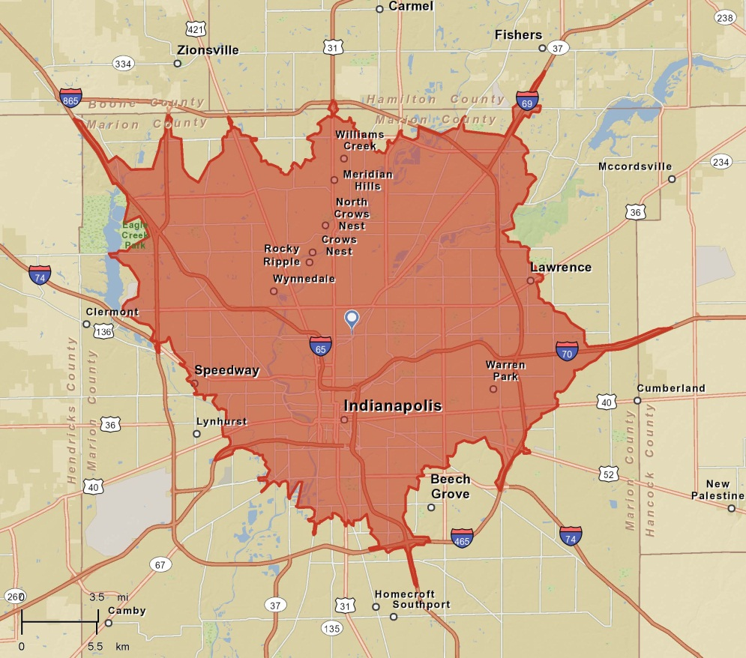
Location, Location, Location
A shorter commute is a priority for many residents. MFC is a 15-minute drive from all of Indianapolis’ major employment centers, all of its major universities, as well as its sporting and entertainment districts.
N
15-Minute Drive
Sources: 2012 MIBOR Community Preferences Survey, ESRI
November 2013 | © Mapleton-Fall Creek Development Corporation | 3
Notes:
The Mapleton-Fall Creek neighborhood is centrally located between Broad Ripple Village and Downtown Indianapolis, making many of the city's best entertainment, dining, shopping, and recreation options just a short bike or car ride away. Within the boarders of Mapleton-Fall Creek, one will find many wonderful amenities like bike trails, parks, schools, grocery stores, restaurants, and churches. Mapleton-Fall Creek is also home to many beautiful turn of the century homes and several active Neighborhood Associations.

Slide 4
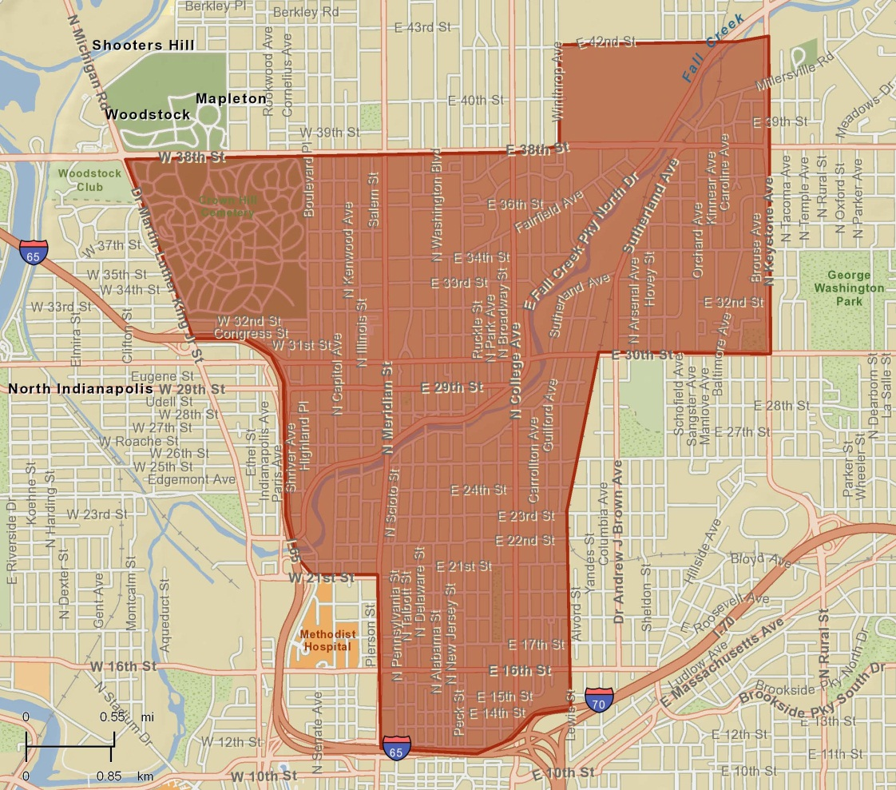
Mapleton-Fall Creek Neighborhoods
Watson Park Historic District
Historic Meridian Park
Mapleton-Fall Creek
N
Sources: Mapleton-Fall Creek Community Development Corporation
2013 | © Mapleton-Fall Creek Development Corporation | 4

Slide 5
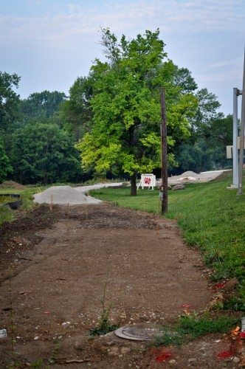
Infrastructure Investment
The City of Indianapolis has been investing in the area around Fall Creek, including road, bridge, trail and CSO work.
Fall Creek Trail extension connecting Monon to Central Ave.: $1.25 million
Illinois St Bridge over Fall Creek: $3.5 million rehab
Meridian St Bridge over Fall Creek: $2.5 million rehab
Long Term Control Plan for Sewer overflows: $1.7 billion
Sources: Indianapolis Dept. of Public Works, photo: urbanindy.com
2013 | © Mapleton-Fall Creek Development Corporation | 5

Slide 6
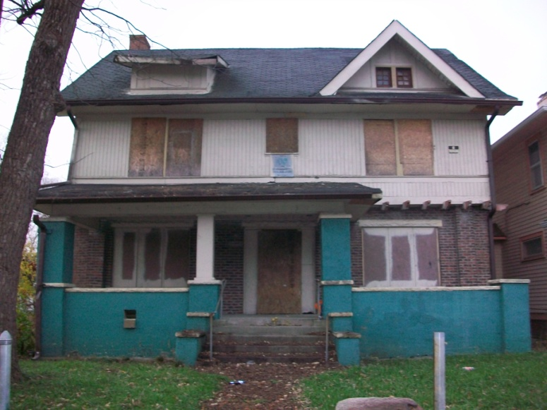
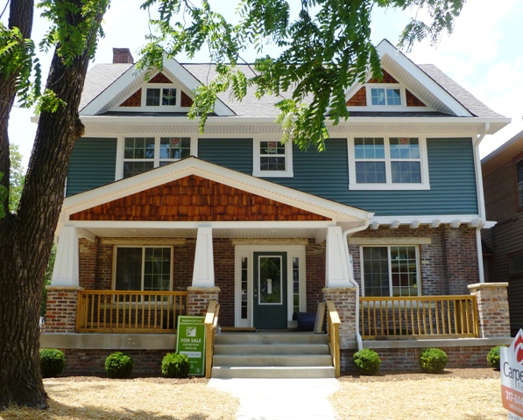
Recent Residential Investment
Before photo of 3028 Park Avenue
After photo of 3028 Park Avenue
Since 2009
Total LISC Investment $11,713,810
Total Leverage (inc. NSP) $41,709,639
Housing Units Developed 33
Square Feet Improved 28,400
2013 | © Mapleton-Fall Creek Development Corporation | 6

Slide 7
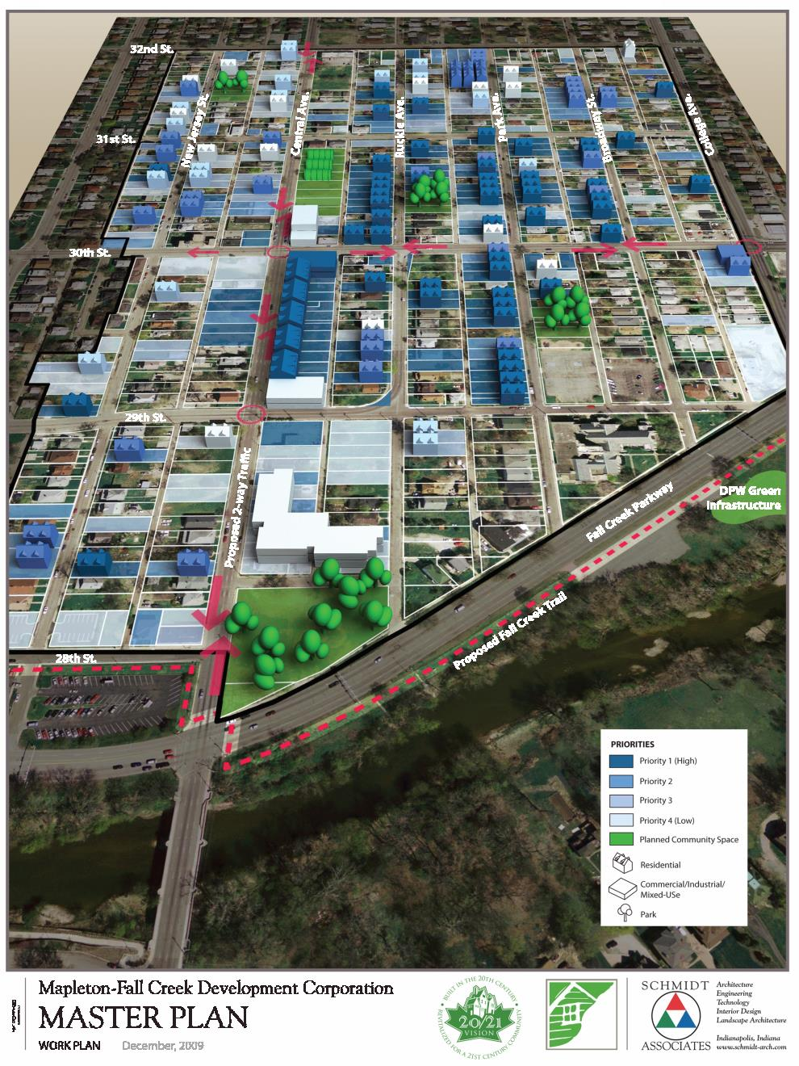
TEMPLE HERITAGE CENTER
SITE
INDIANAPOLIS, INDIANA USA

Slide 8
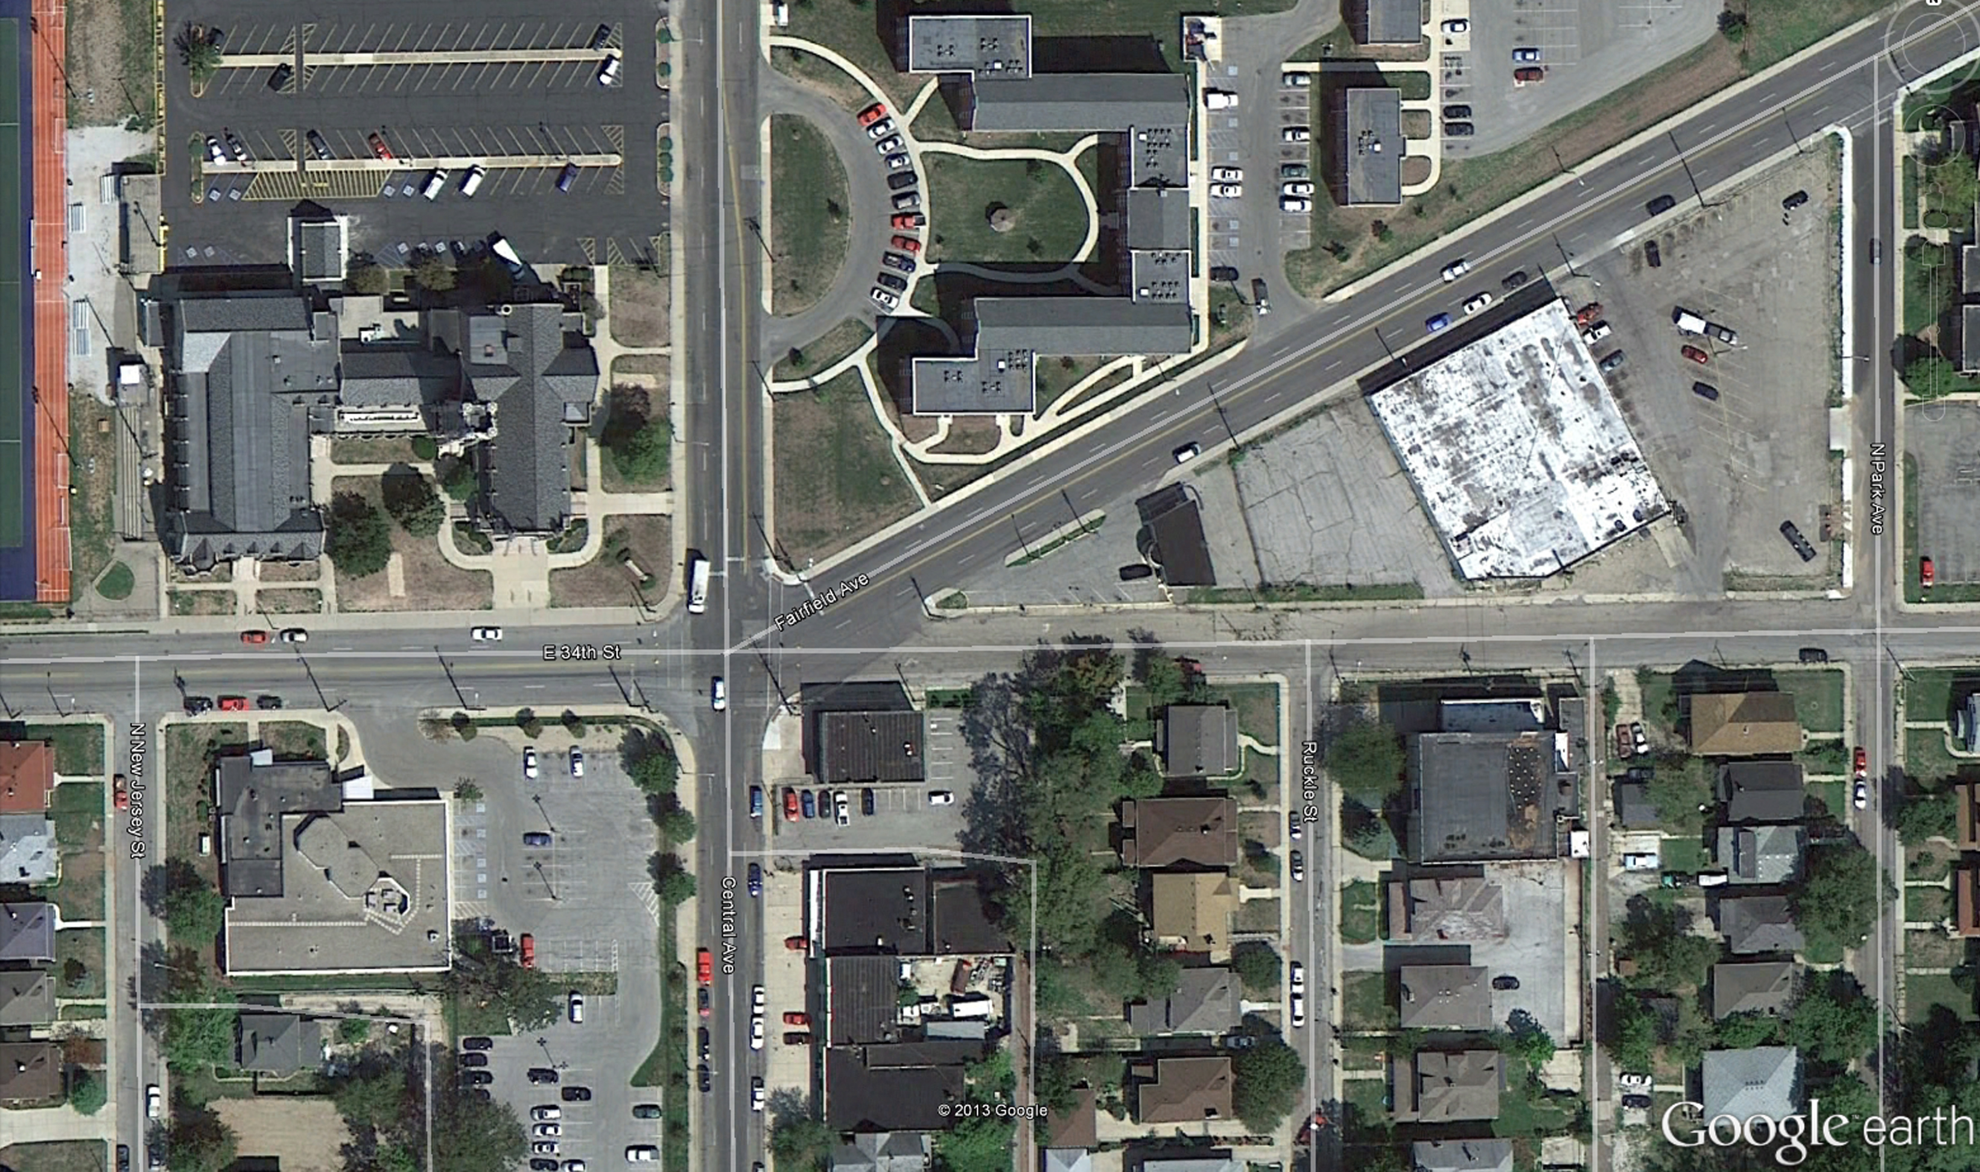
YOU ARE HERE
CENTRAL AVENUE
TEMPLE HERITAGE
CENTER SITE
34 TH STREET
PARK AVENUE
RUCKLE STREET
TEMPLE HERITAGE CENTER
SITE
INDIANAPOLIS, INDIANA USA

Slide 9
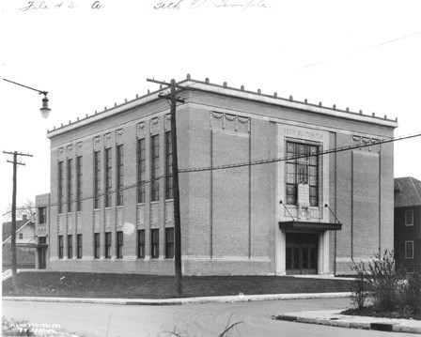
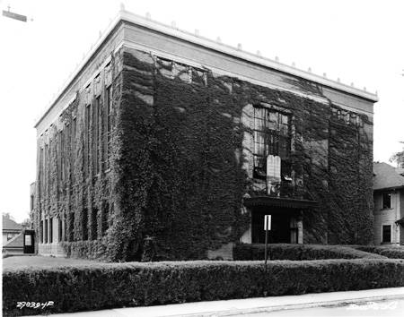
TEMPLE HERITAGE CENTER
ca. 1925
INDIANAPOLIS, INDIANA USA
Notes:
-CONGREGATION BETH-EL ESTABLISHED IN 1915 FROM FORMER LEADERS OF A CONGREGATION OF POLISH IMMIGRANTS
-BETH-EL TEMPLE WAS CONSTRUCTED IN 1924-1925
-CONGREGATION BETH-EL MERGED WITH OHEV ZEDECK (A HUNGARIAN IMMIGRANT FOUNDED CONGREGATION) IN 1928
-NEW CONGREGATION CALLED CONGREGATION BETH-EL ZEDECK
-BETH-EL ZEDECK MOVED TO CURRENT LOCATION IN 1958
-UNITED CENTRAL HEBREW CONGREGATION, AN ORTHODOX CONGREGATION, MET IN BETH-EL TEMPLE UNTIL 1967
-VARIOUS CHRISTIAN CHURCHES AFTER 1967

Slide 10
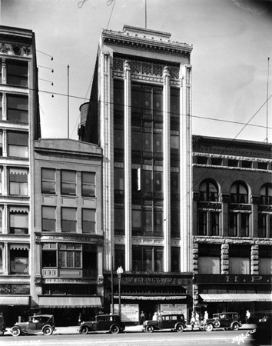
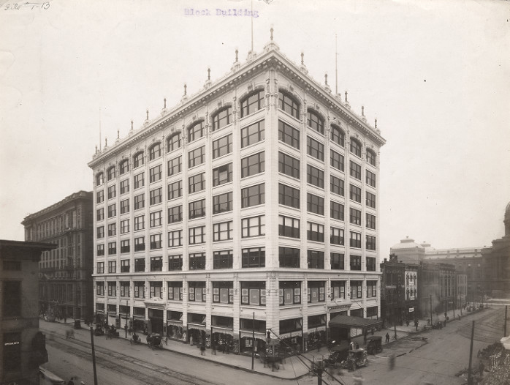
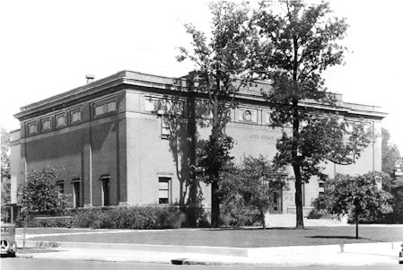
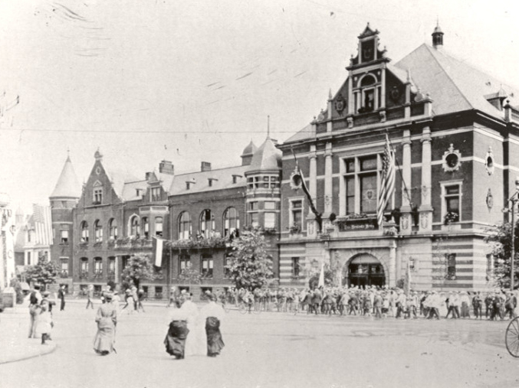
1911
1924
1906
1890s
TEMPLE HERITAGE CENTER
ARCHITECT
INDIANAPOLIS, INDIANA USA

Slide 11
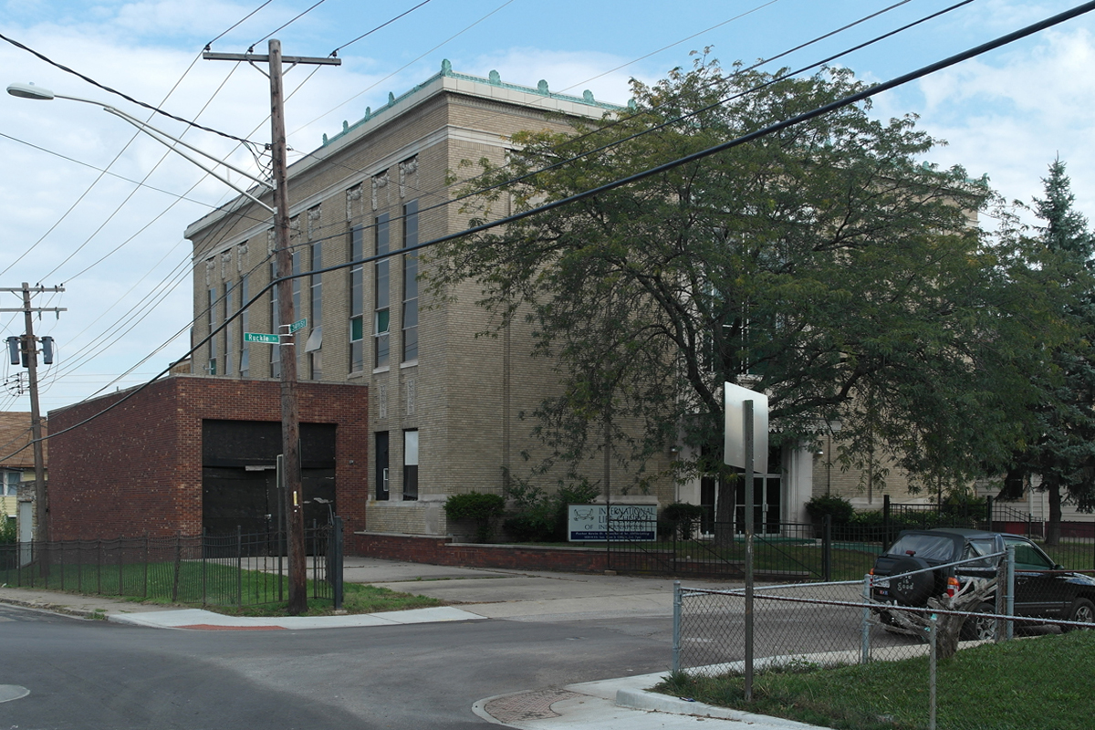
TEMPLE HERITAGE CENTER
EXTERIOR
INDIANAPOLIS, INDIANA USA

Slide 12
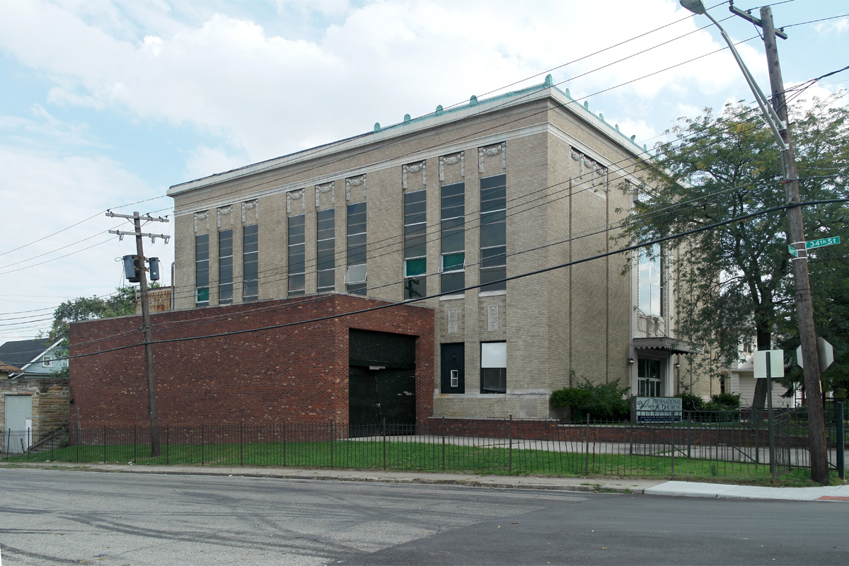
TEMPLE HERITAGE CENTER
EXTERIOR
INDIANAPOLIS, INDIANA USA

Slide 13
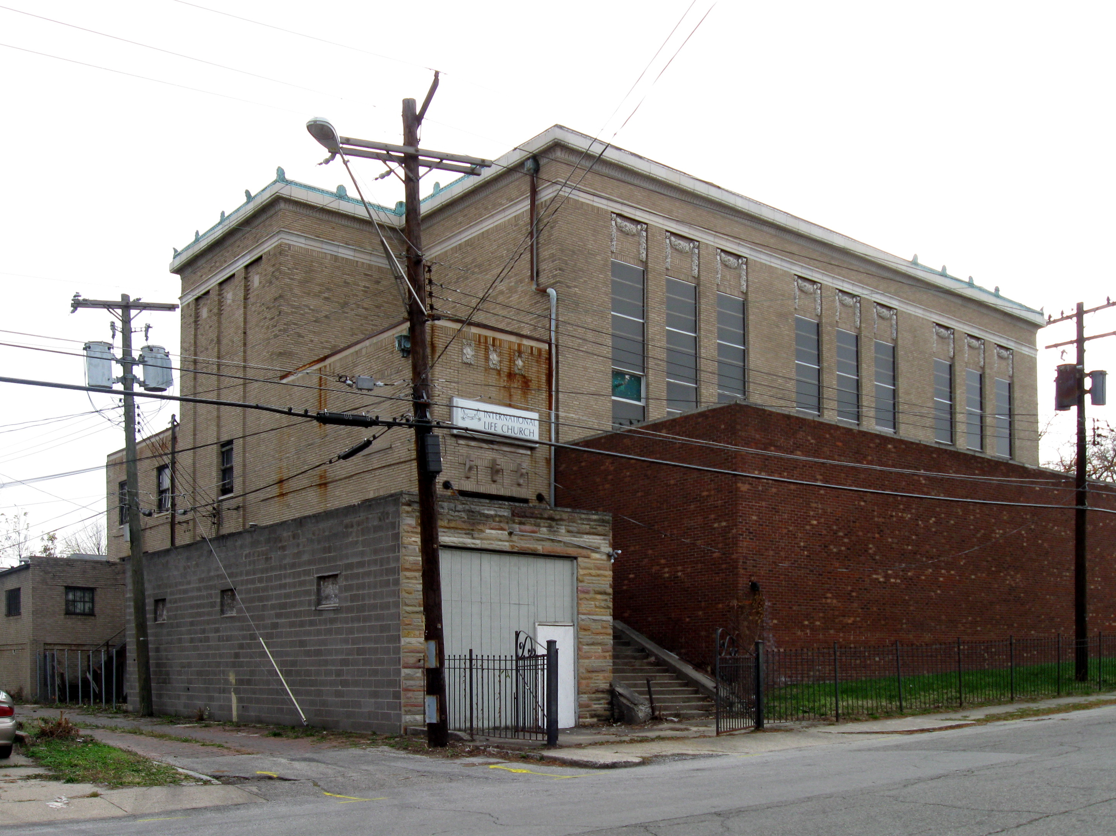
TEMPLE HERITAGE CENTER
EXTERIOR
INDIANAPOLIS, INDIANA USA

Slide 14
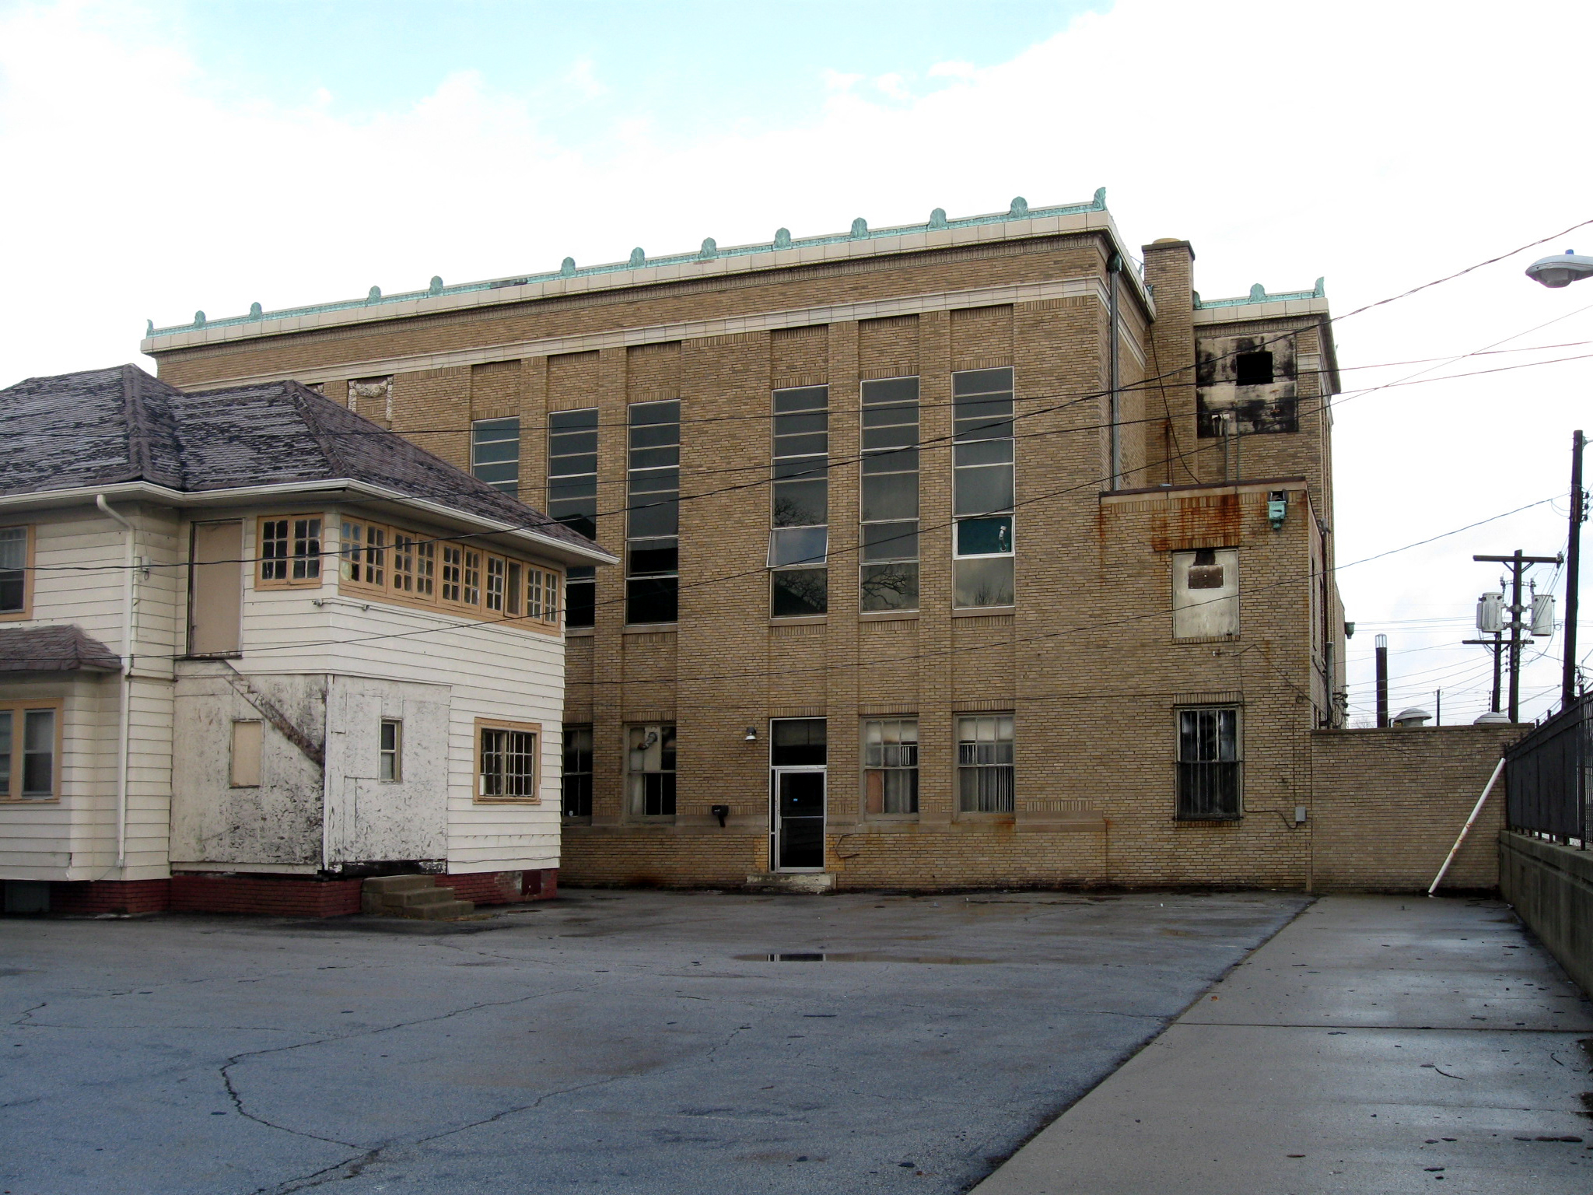
TEMPLE HERITAGE CENTER
EXTERIOR
INDIANAPOLIS, INDIANA USA

Slide 15
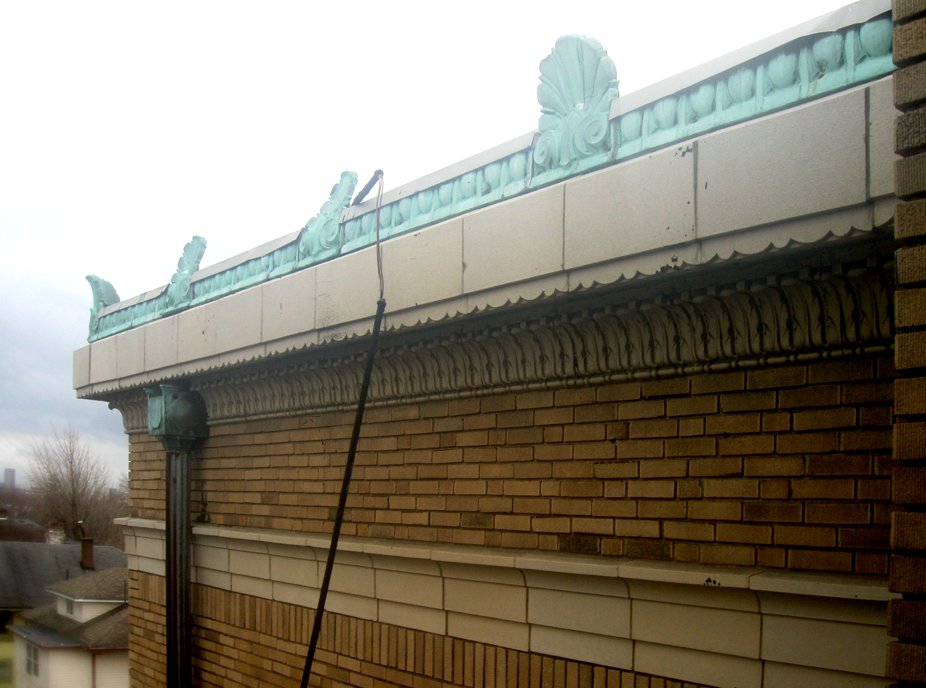
TEMPLE HERITAGE CENTER
EXTERIOR
INDIANAPOLIS, INDIANA USA

Slide 16
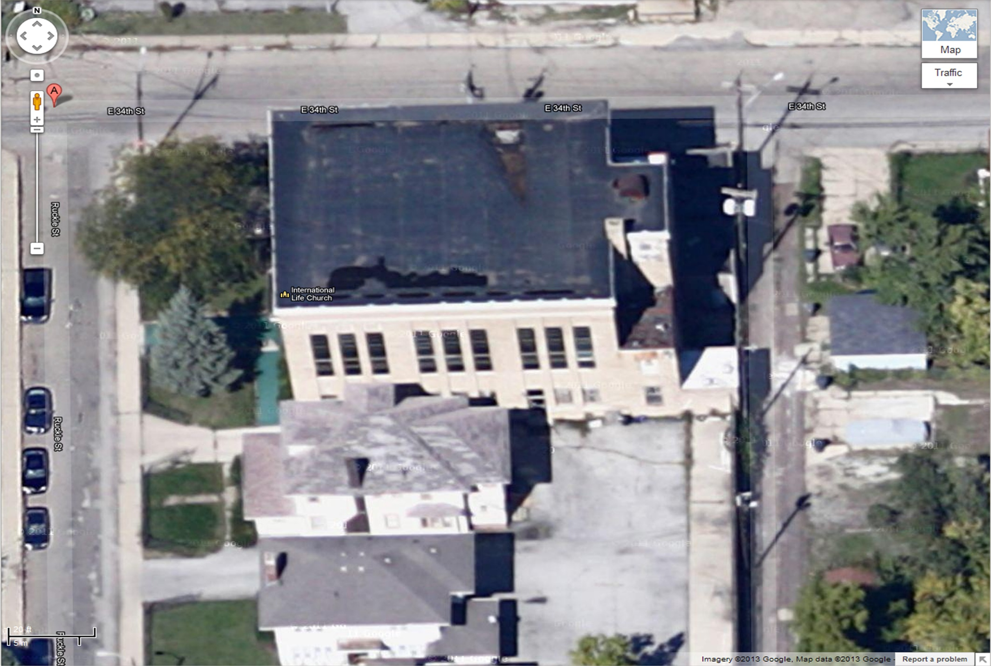
TEMPLE HERITAGE CENTER
ROOF
INDIANAPOLIS, INDIANA USA

Slide 17
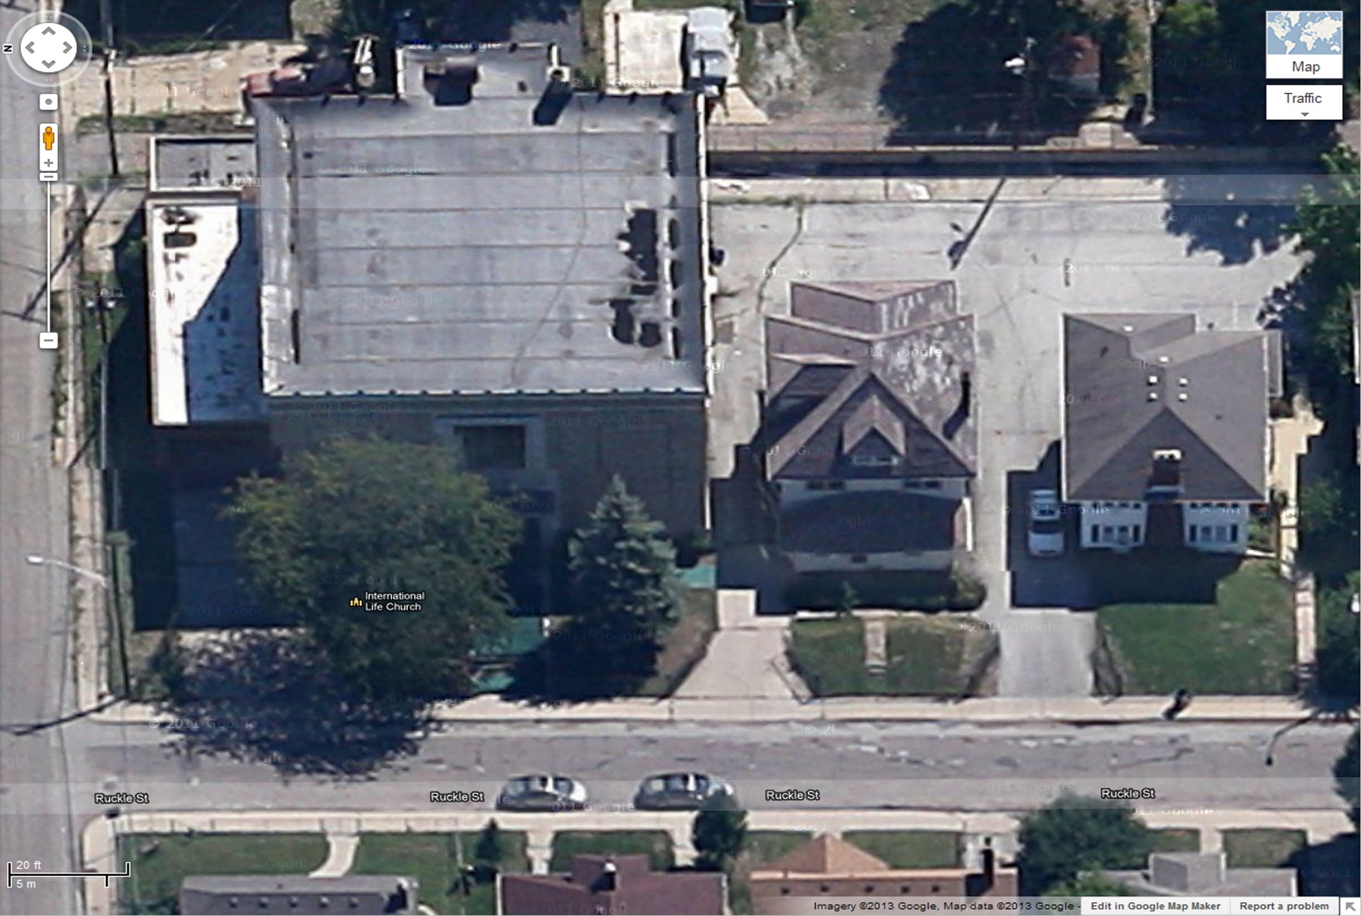
AREA #1
+-5700 SF EXISTING EPDM SINGLE PLY OVER BUILT UP ROOF AND WOOD DECK
TEMPLE HERITAGE CENTER
ROOF
INDIANAPOLIS, INDIANA USA

Slide 18
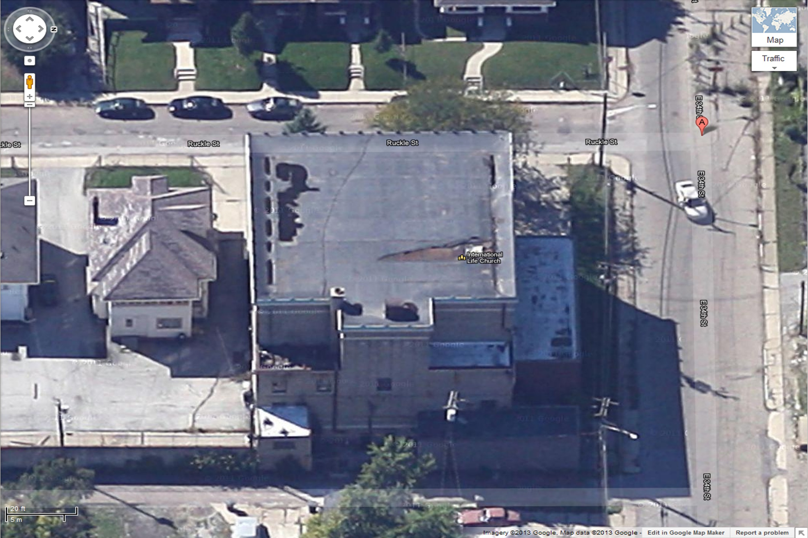
AREA #3
+-280 SF EXISTING EPDM SINGLE PLY OVER WOOD DECK
AREA #2
+-280 SF EXISTING PVC SINGLE PLY OVER WOOD DECK
AREA #4
+-235 SF EXISTING PVC SINGLE PLY OVER CONCRETE DECK
TEMPLE HERITAGE CENTER
ROOF
INDIANAPOLIS, INDIANA USA

Slide 19
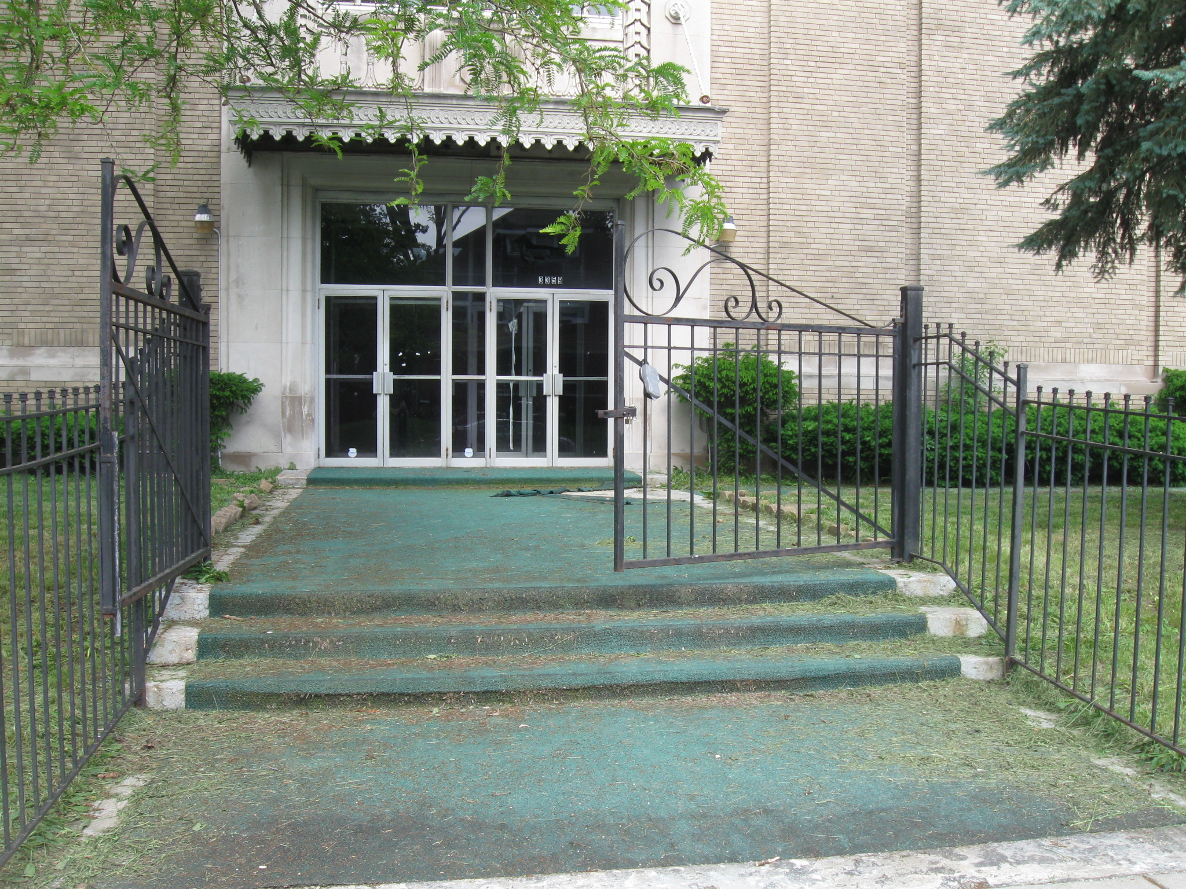
TEMPLE HERITAGE CENTER
ENTRANCE
INDIANAPOLIS, INDIANA USA

Slide 20
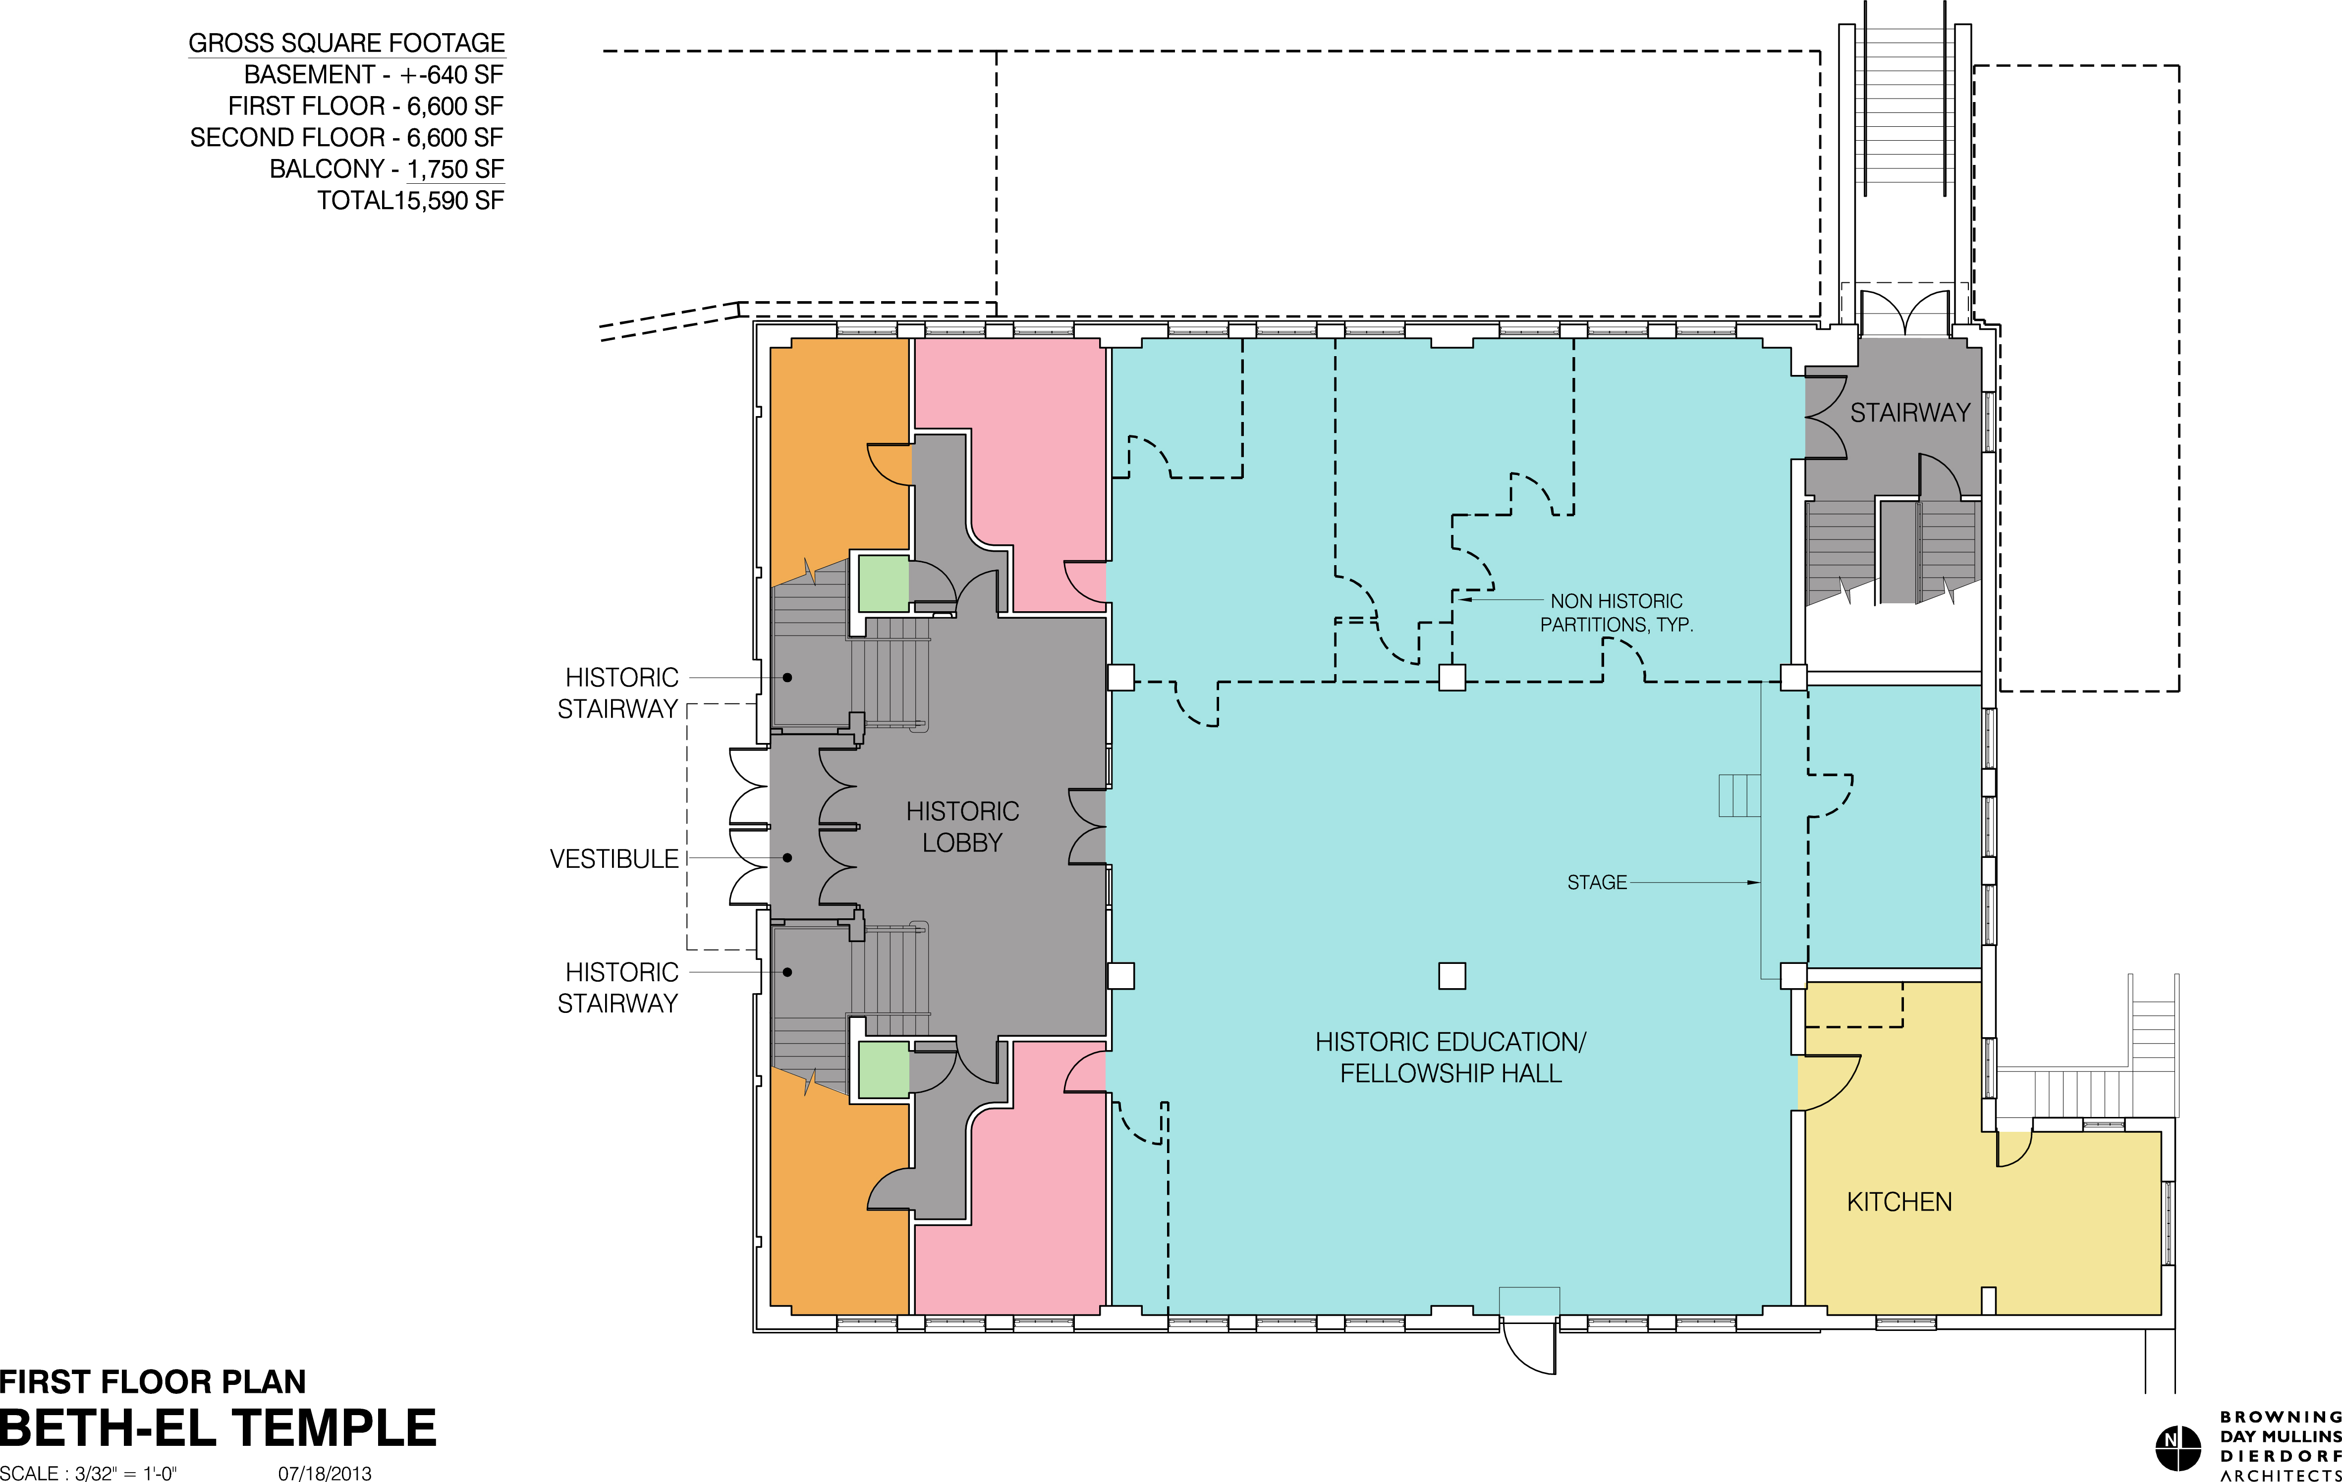
TEMPLE HERITAGE CENTER
FIRST FLOOR PLAN
INDIANAPOLIS, INDIANA USA

Slide 21
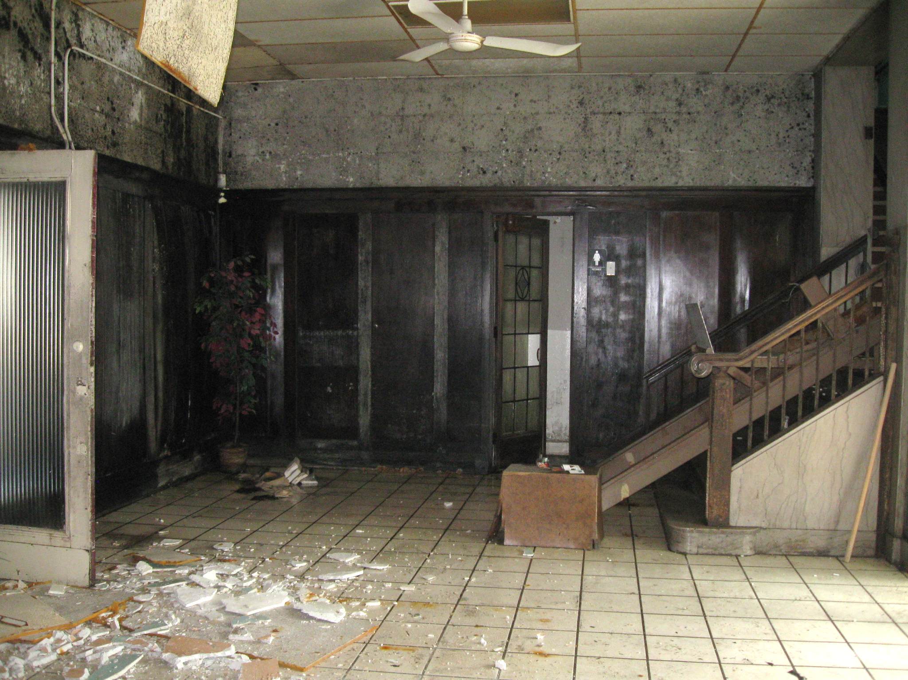
TEMPLE HERITAGE CENTER
FIRST FLOOR PLAN
INDIANAPOLIS, INDIANA USA

Slide 22
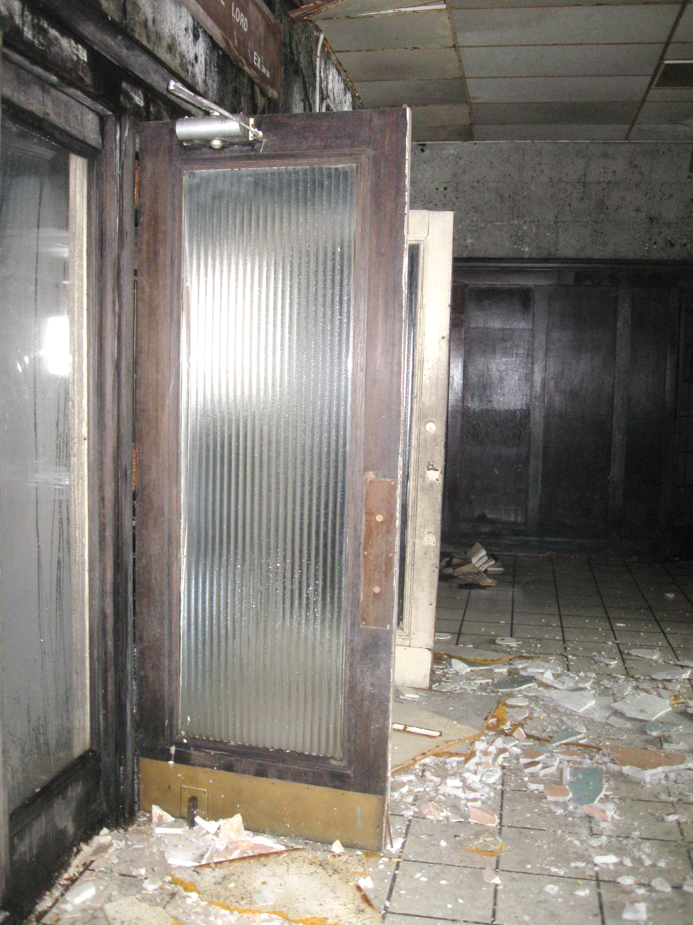
TEMPLE HERITAGE CENTER
FIRST FLOOR PLAN
INDIANAPOLIS, INDIANA USA

Slide 23
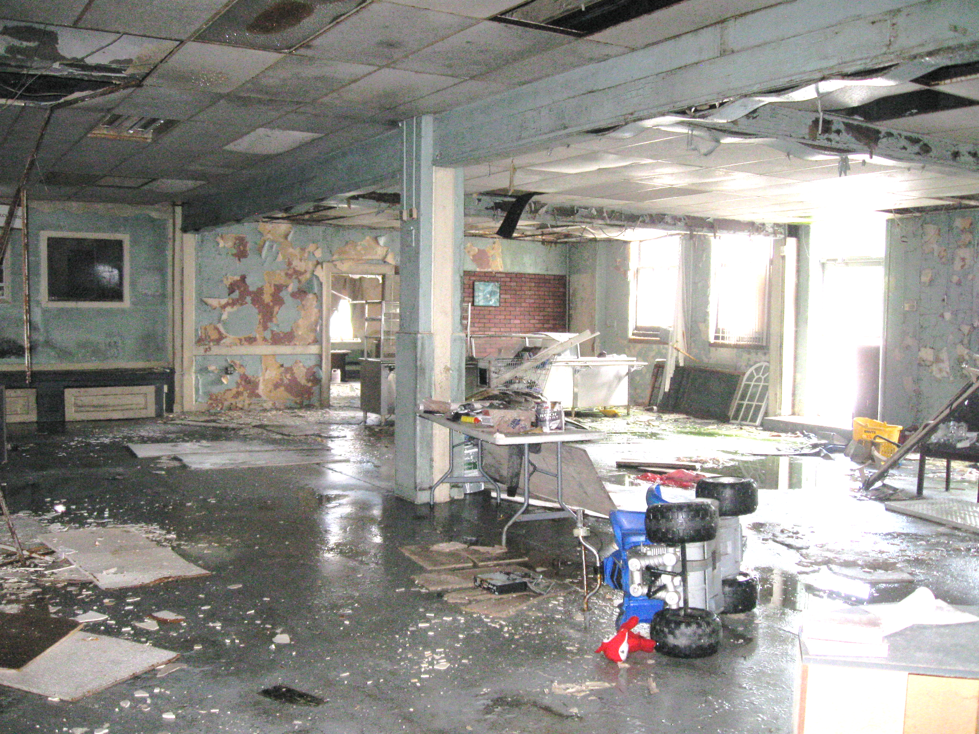
TEMPLE HERITAGE CENTER
FIRST FLOOR PLAN
INDIANAPOLIS, INDIANA USA

Slide 24
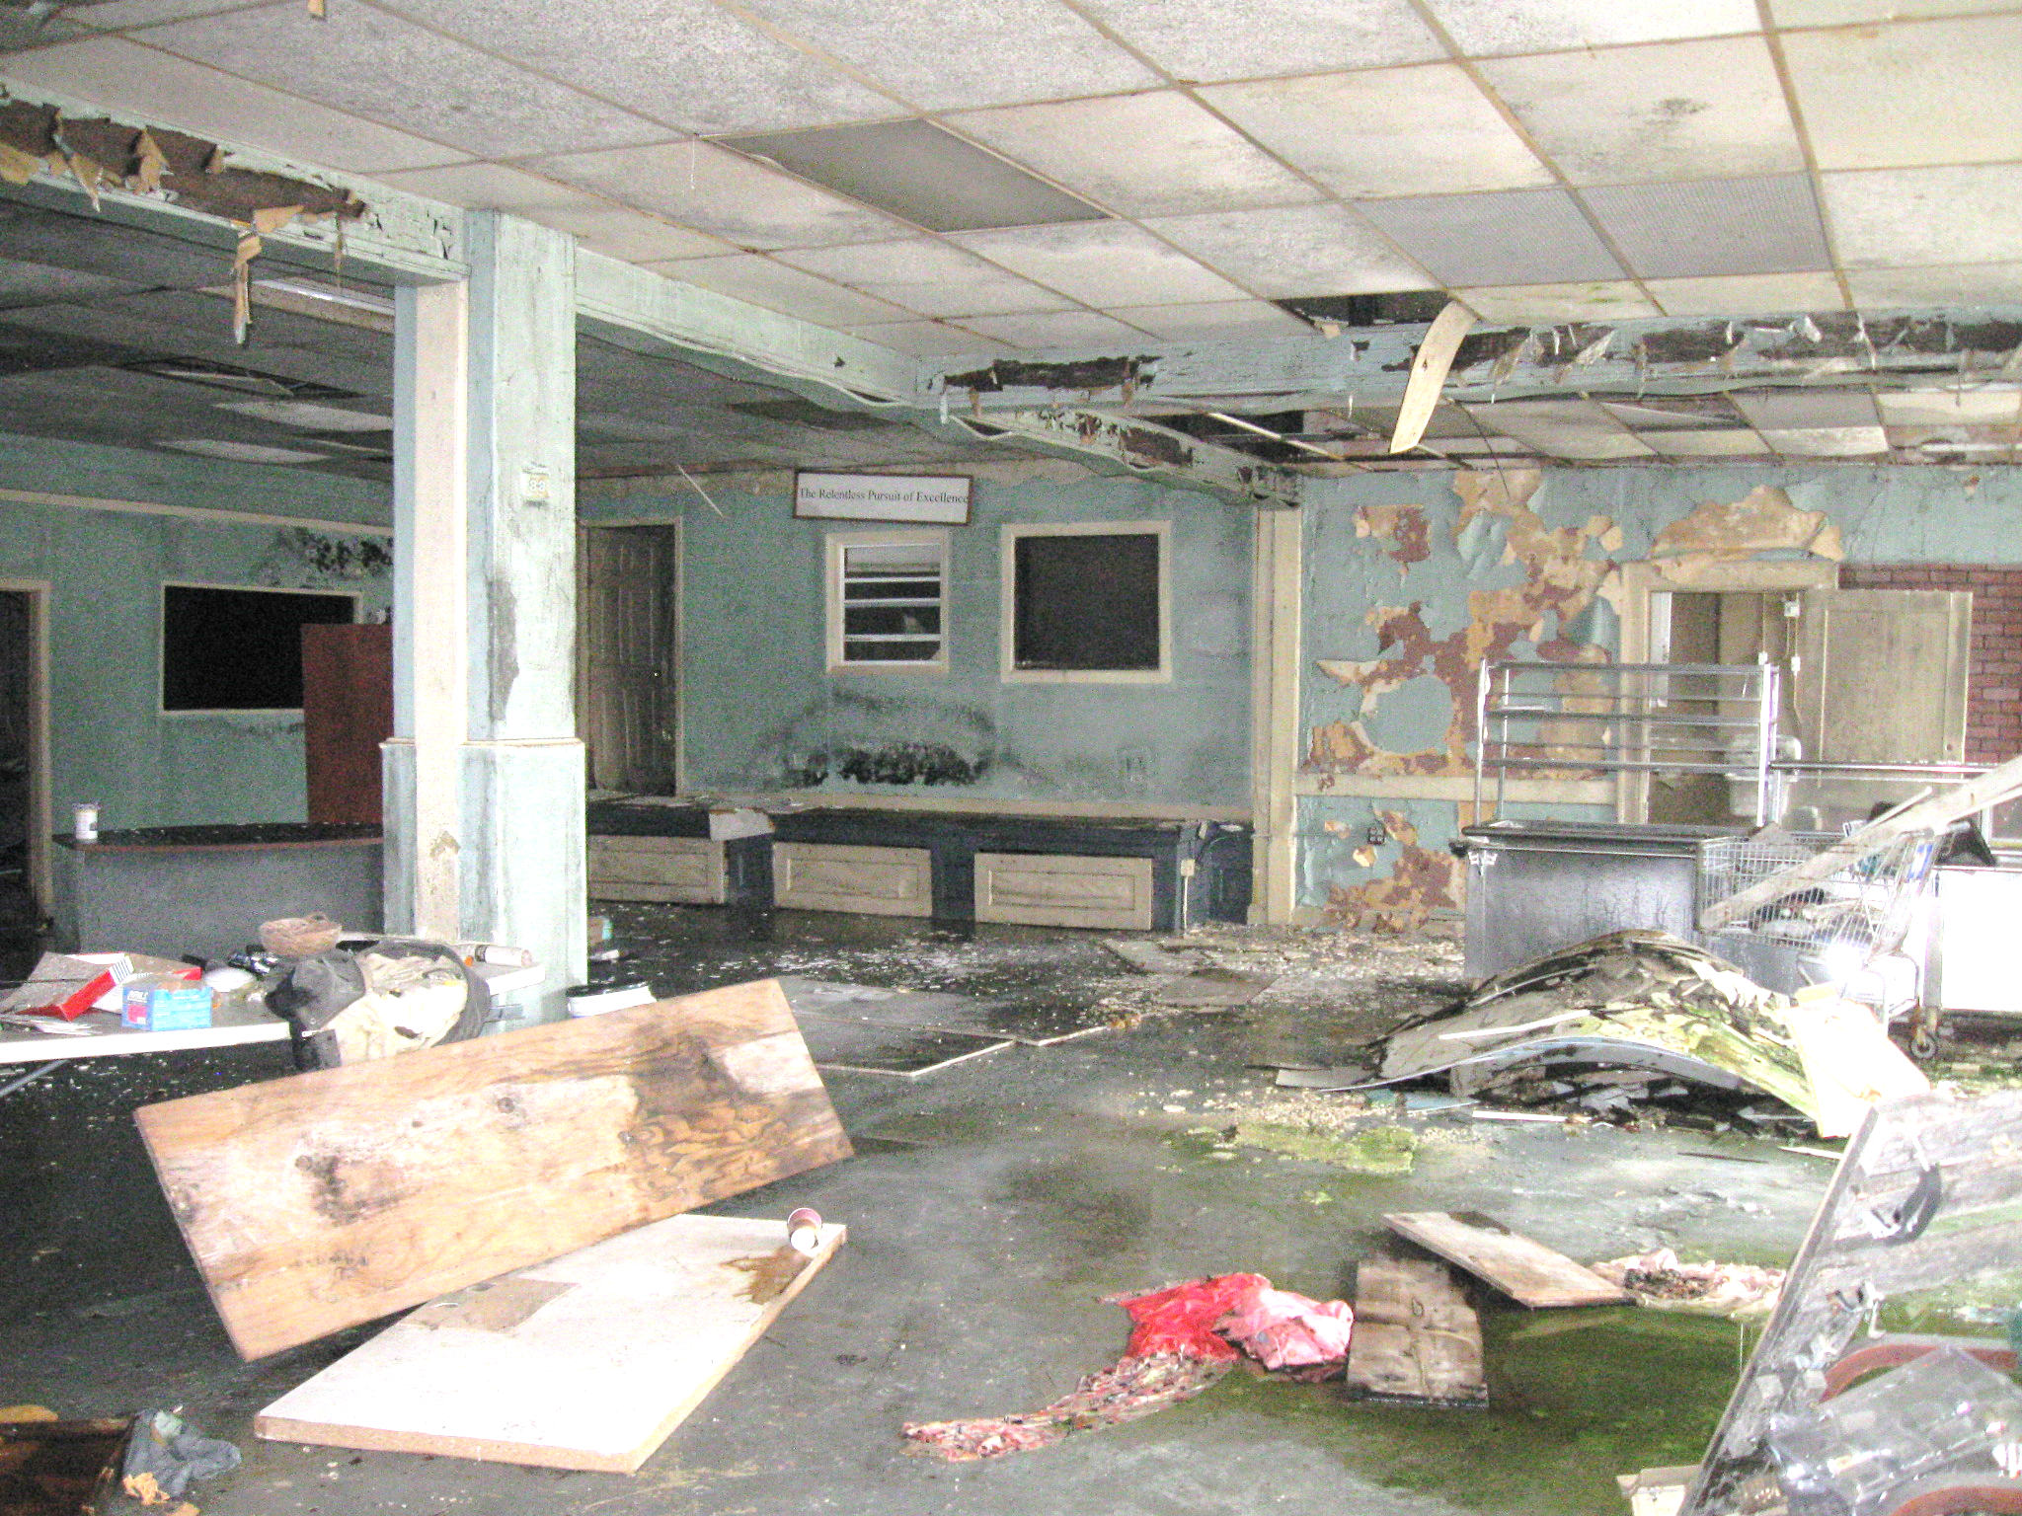
TEMPLE HERITAGE CENTER
FIRST FLOOR PLAN
INDIANAPOLIS, INDIANA USA

Slide 25
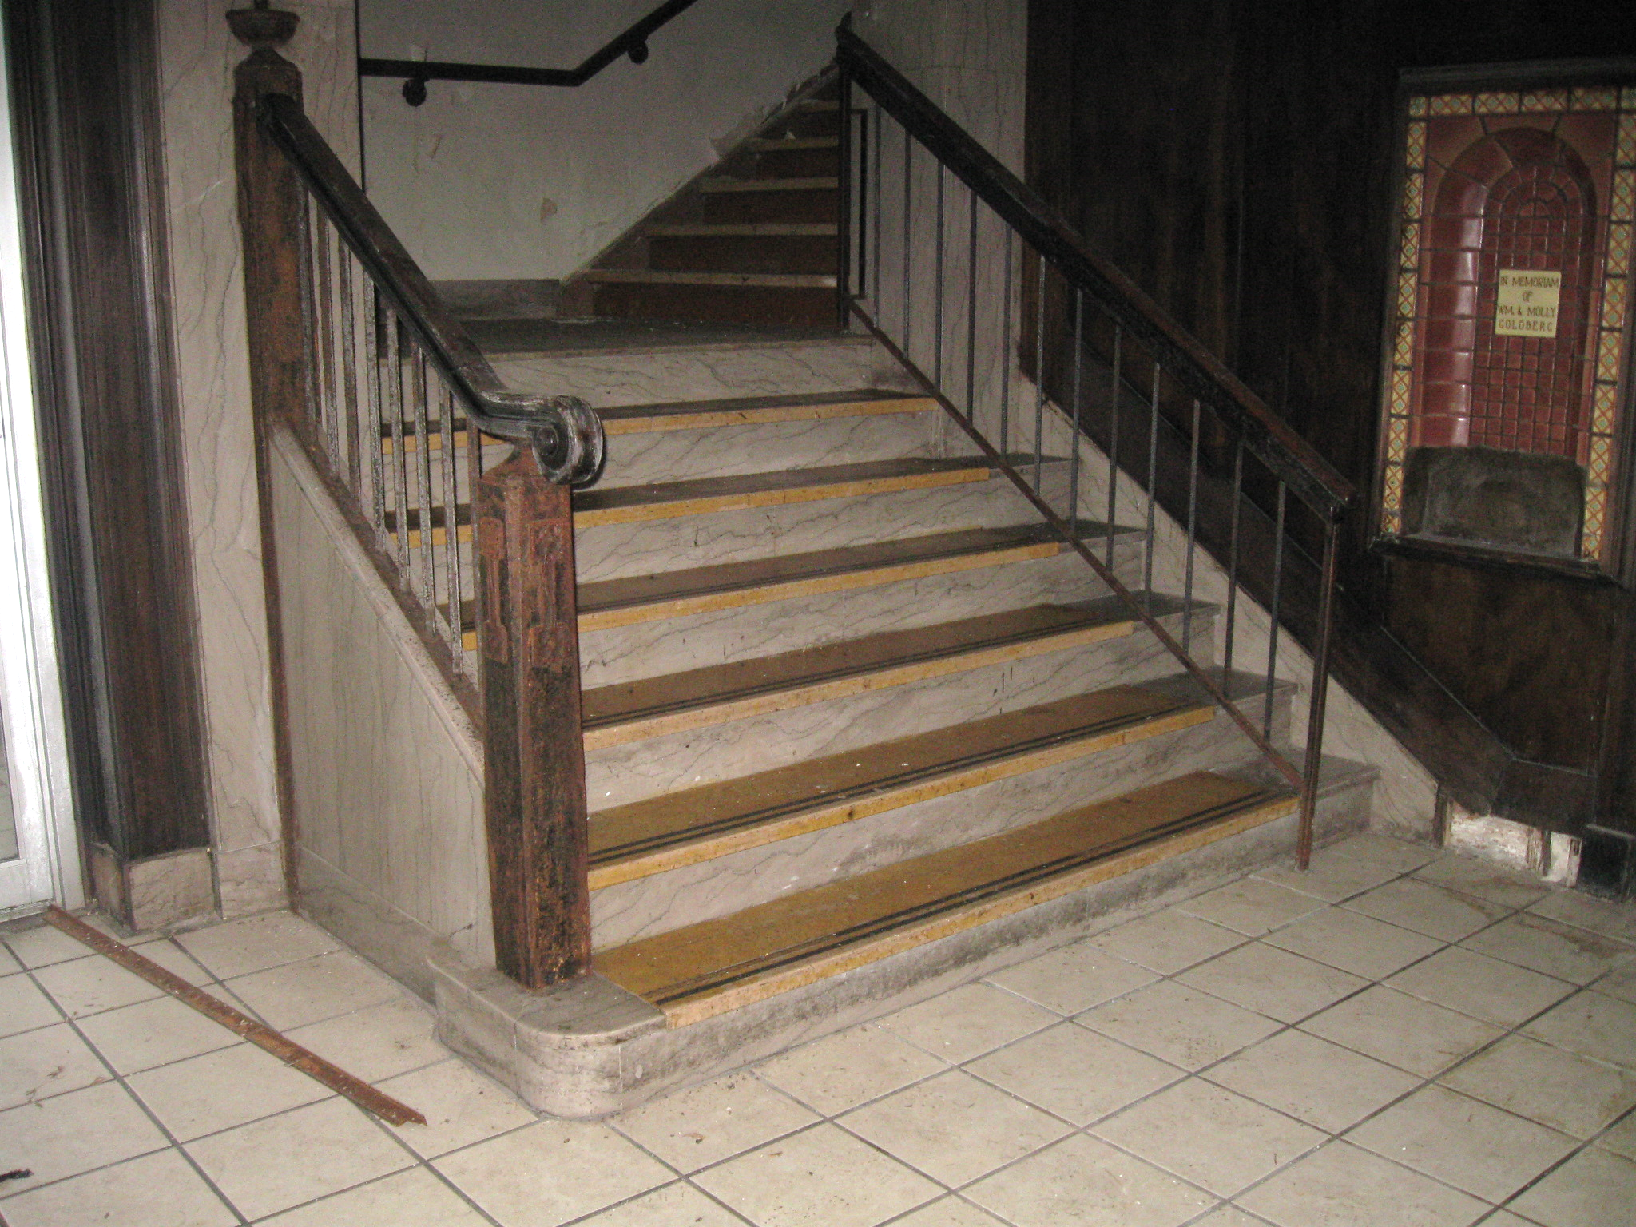
TEMPLE HERITAGE CENTER
FIRST FLOOR PLAN
INDIANAPOLIS, INDIANA USA

Slide 26
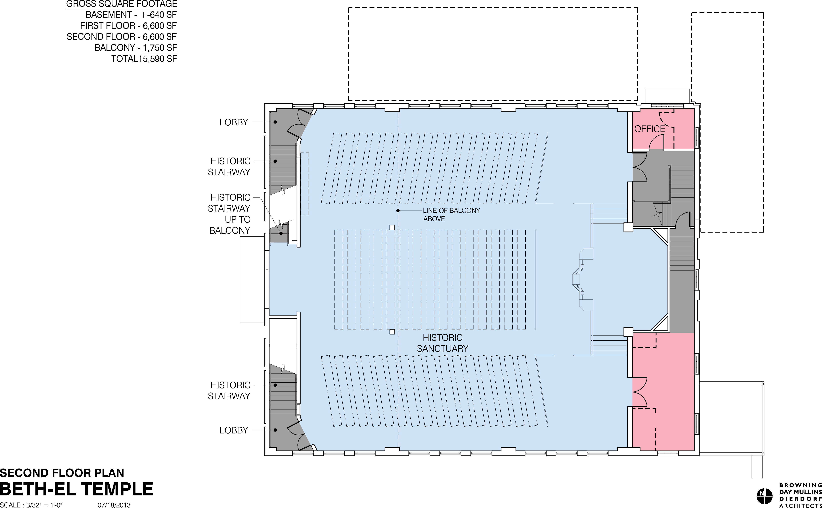
TEMPLE HERITAGE CENTER
SECOND FLOOR PLAN
INDIANAPOLIS, INDIANA USA

Slide 27
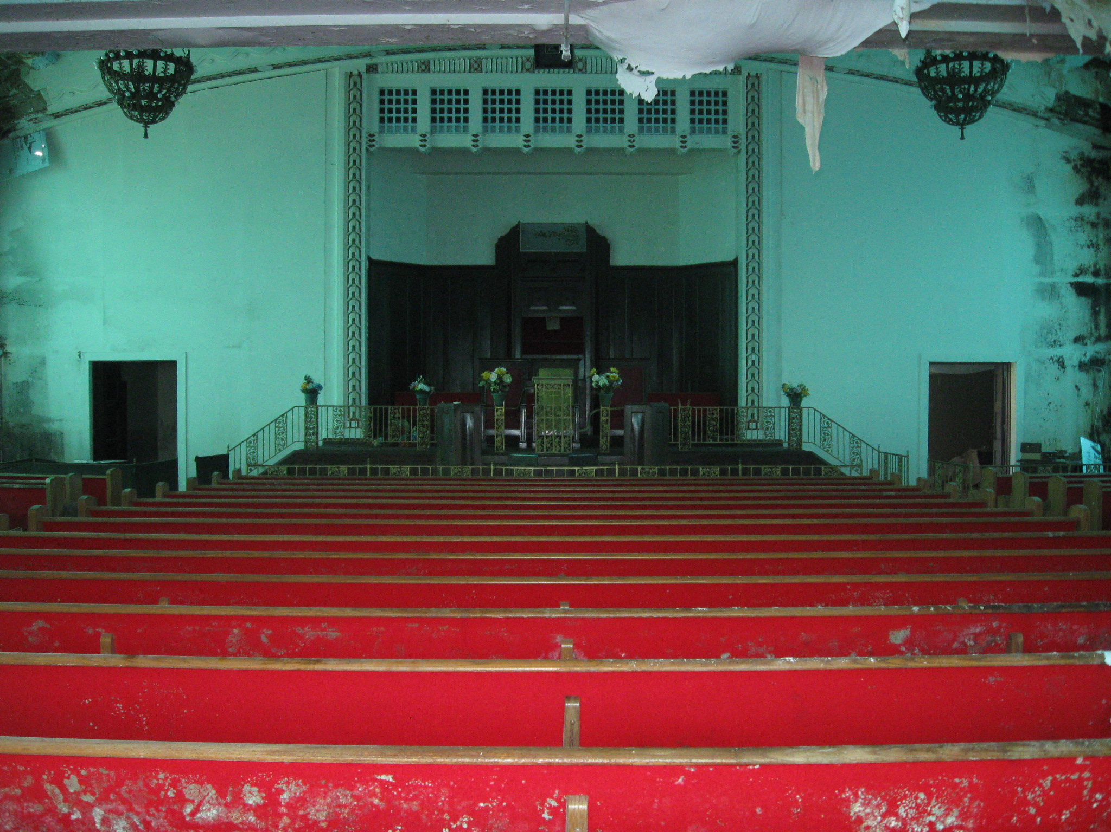
TEMPLE HERITAGE CENTER
SECOND FLOOR PLAN
INDIANAPOLIS, INDIANA USA

Slide 28
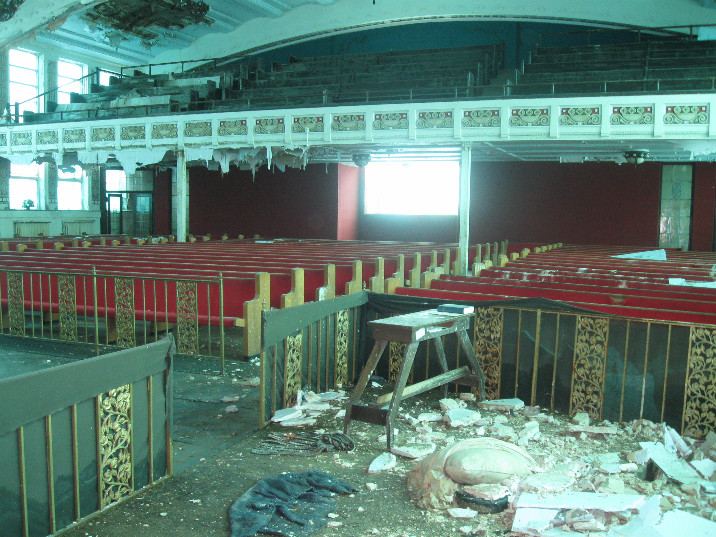
TEMPLE HERITAGE CENTER
SECOND FLOOR PLAN
INDIANAPOLIS, INDIANA USA

Slide 29
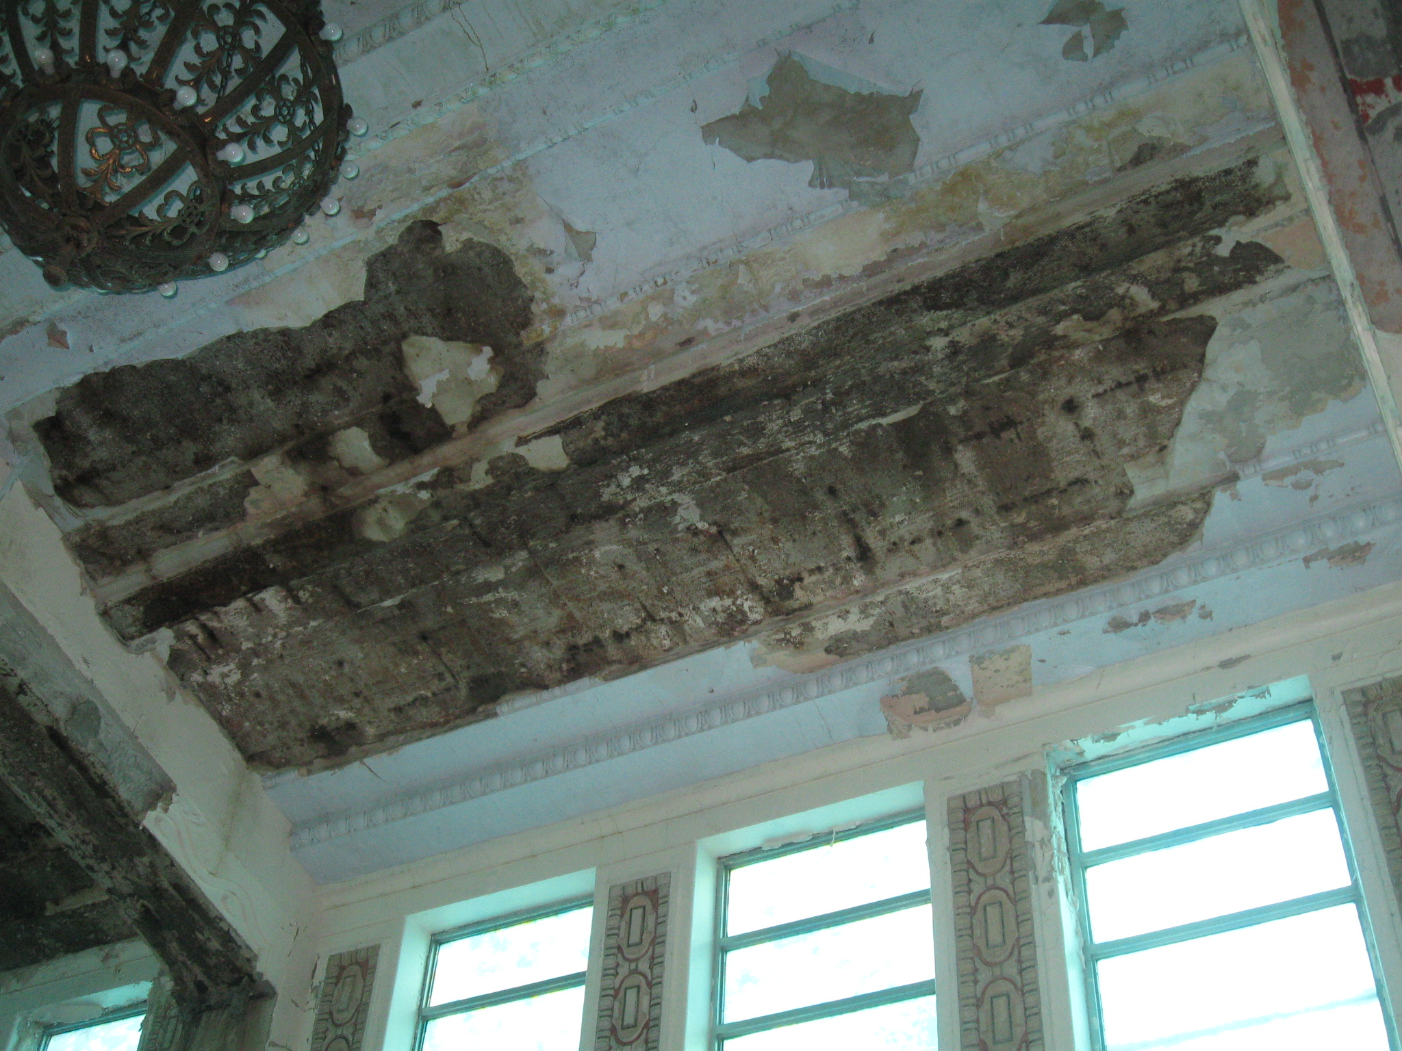
TEMPLE HERITAGE CENTER
SECOND FLOOR PLAN
INDIANAPOLIS, INDIANA USA

Slide 30
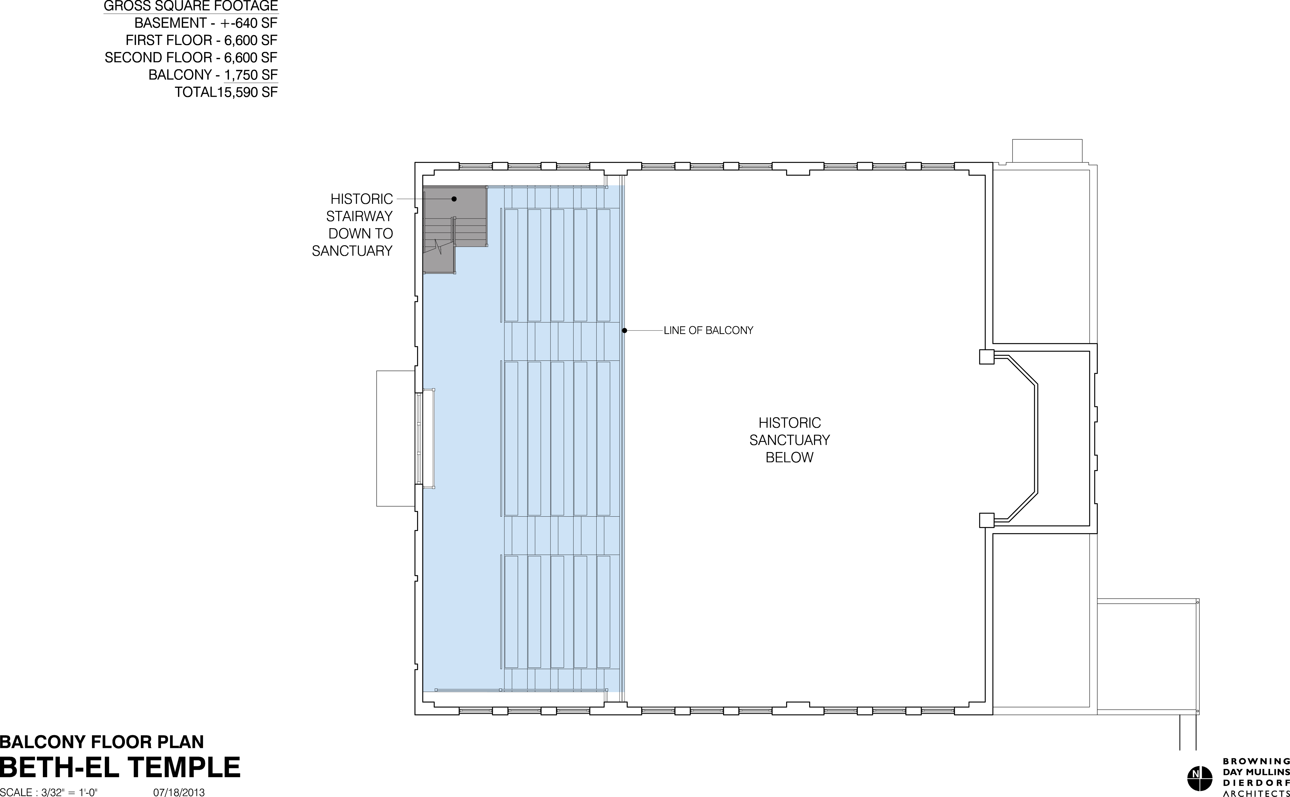
TEMPLE HERITAGE CENTER
BALCONY FLOOR PLAN
INDIANAPOLIS, INDIANA USA

Slide 31
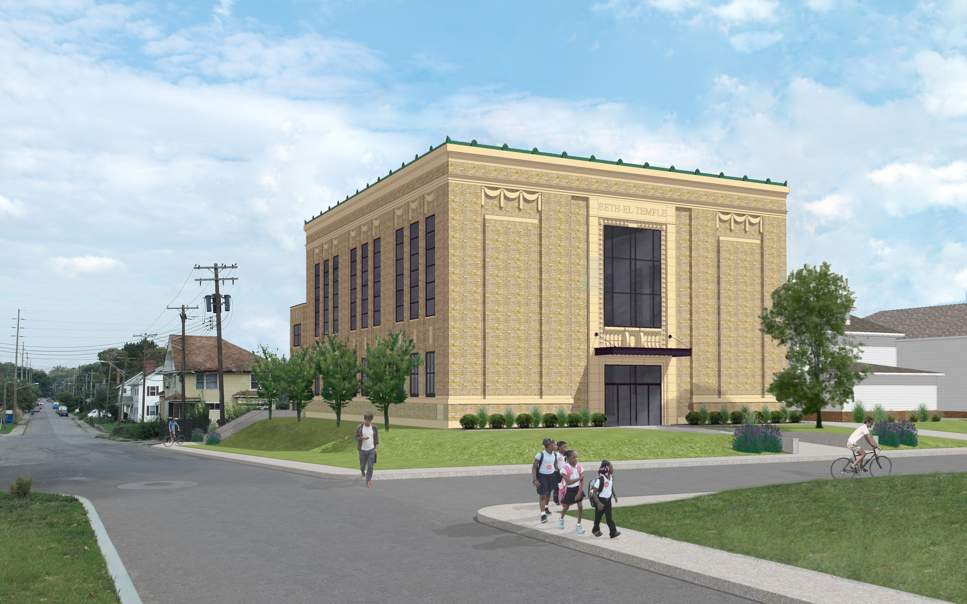
TEMPLE HERITAGE CENTER
RENDERING
INDIANAPOLIS, INDIANA USA

Slide 32
TEMPLE HERITAGE CENTER
MOVIE
INDIANAPOLIS, INDIANA USA

