Slide 1
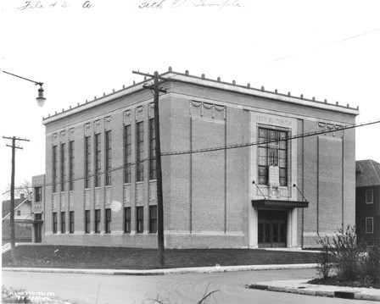
Mapleton-Fall Creek Development Corp. Board of Directors meeting May 28th, 2013
Tyson Domer
tyson@hundredyear.net
Temple Heritage Center, Inc. CDBG Proposal

Slide 2
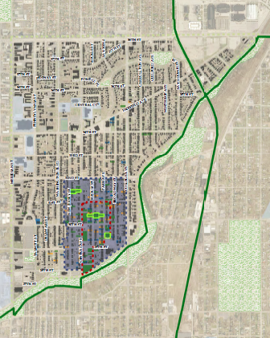
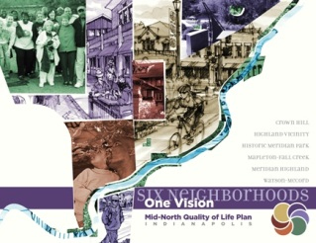
Context a community hub in the heart of Mapleton-Fall Creek
Fairfield & Central
Freewheelin’ Community Bikes
Tabernacle Presbyterian Church
Double 8 Foods
connected, walkable, destination
Central Avenue 2-way conversion
Fall Creek Gardens
proposed MFCDC mixed-use development
anchors Fairfield Avenue Corridor
Monon Trail
Indiana State Fair
Notes:
located very nearly at the geographic center of the Mapleton-Fall Creek neighborhood
strategic decision by those who originally sited and built the Temple
Tab sports fields, Rafael Health Center, Phillips Temple, Shortridge Law & Government Magnet High School…across the street
neighborhood retail spaces on 3300 block of Central should be activated by conversion to 2-way
recent MFC Comprehensive Plan Segment update recommends “community commercial” zoning for commercial on Central
recent MFC Comprehensive Plan Segment update recommends retaining existing “special use” (currently church) zoning for Temple properties

Slide 3
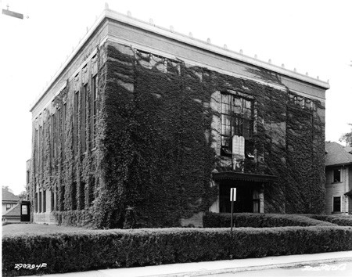
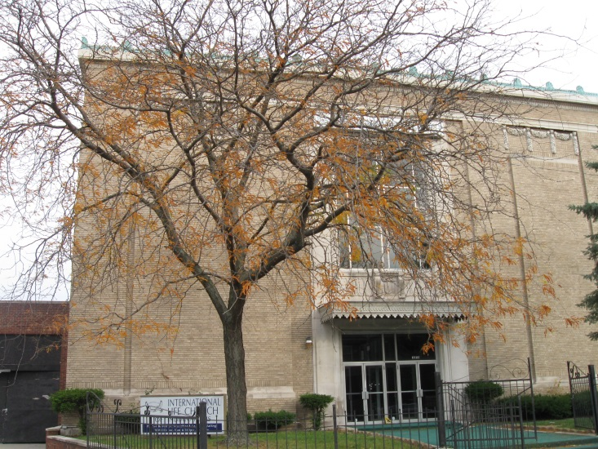
History oldest extant synagogue in the city of Indianapolis
Vonnegut & Bohn design
completed 1924
Athenaeum – Mass Ave.
Block building – Market & Illinois
Beth El Zedeck congregation
original temple
1925 – 1958
other community uses
Crusader for Christ Pentecostal Temple
Deeper Life Christian Church
International Life Church

Slide 4
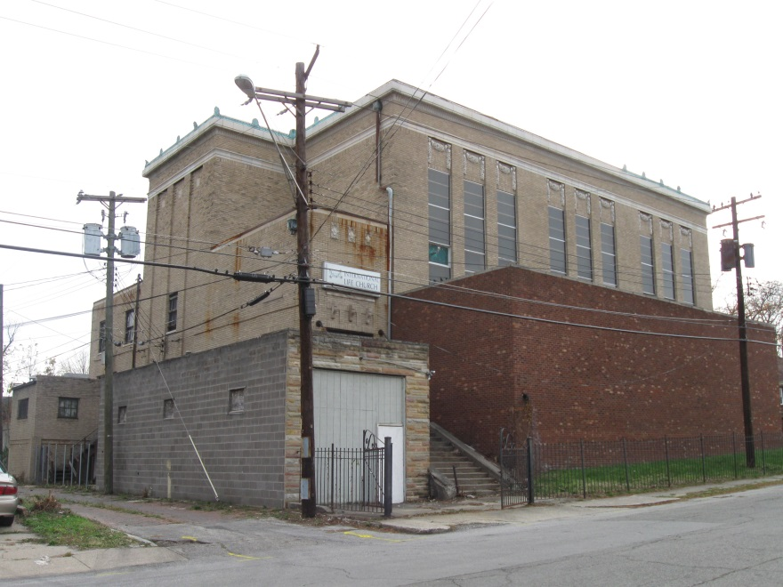
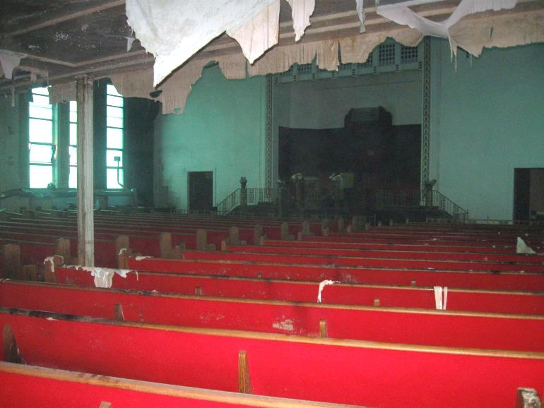
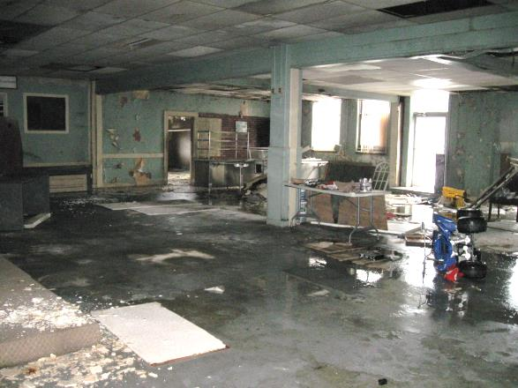
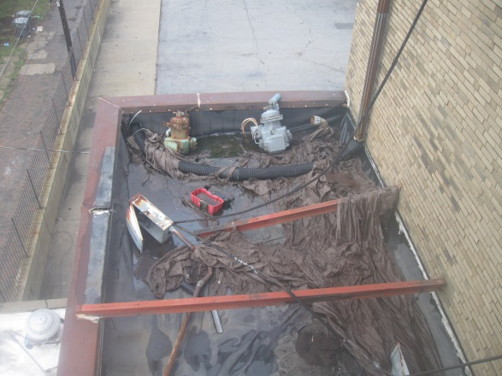
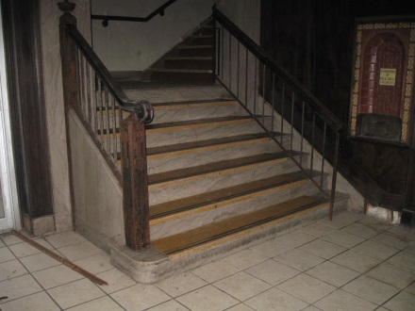
without immediate stabilization, the question is not if, but when?
Existing Conditions blighting influence “demolition by neglect…”

Slide 5
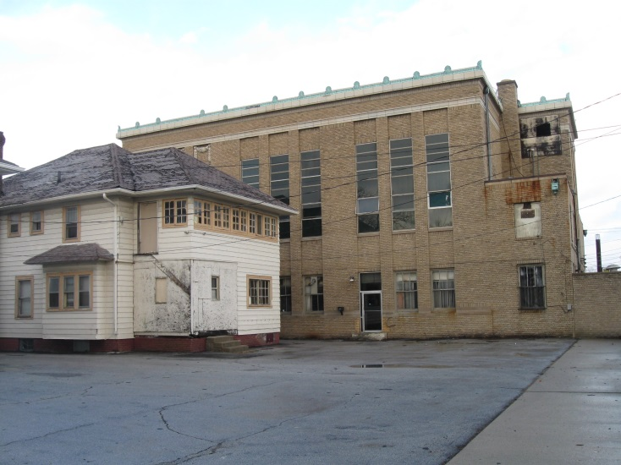
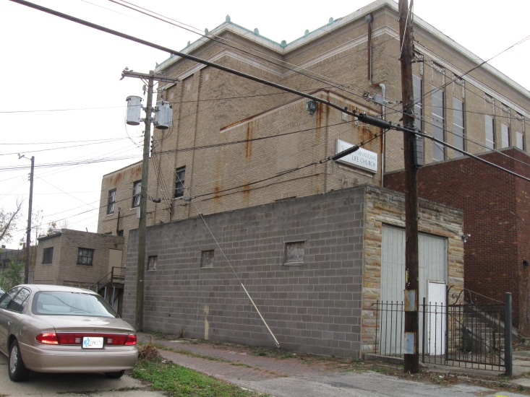
Progress to Date Temple Heritage Center, Inc.
2011
formed working group
pursued acquisition from tax delinquent church
2012
Efroymson Family Foundation – $10K
Indiana Landmarks, MFCDC, BDMD – $5K
feasibility study
engaged Jewish community
2013
established Temple Heritage Center, Inc. non-profit
plan for acquisition, stabilization, end-use
Notes:
Temple Heritage Center, Inc. has initiated dialog with neighbors to the south (Gary Rudgers & Shane Bradshaw) re: acquiring the house at 3357 Ruckle
Gary & Shane would like space for a garden and garage
the temple building may need space for additional parking

Slide 6
Acquisition Plan $48,240+ tax delinquency – county surplus property
County Commissioners – Assessor, Treasurer, Auditor
meeting w/ Auditor Billie Breaux
she requested a stabilization plan…
she requested an end-use scenario…
Metropolitan Development Commission
appointed board – Mayor, Council, Commissioners
decision-making body on disposition of county surplus property
Temple Heritage Center, Inc.
secure stabilization funding
request Commissioners/MDC transfer property to Indiana Landmarks
responsible for ongoing property holding & maintenance
conduct community visioning charrette to determine viable end-use scenario

Slide 7
Stabilization Plan $190K Community Development Block Grant – MFCDC
2011 CDBG grant
MFCDC proposed to develop business incubator in former Frogg’s at 30th & College
City DMD has agreed to consider re-allocation from job creation to blight reduction
2013 grant deadline
investment in the community – asset preservation
MFCDC leverages grant funding to attract beneficial private investment
$2.3M estimated total project costs – 10x leverage!
timeline
Q3 2013 – acquisition, bid solicitation, finalize contracts
Q4 2013 – roof repair, demolition of non-historic additions, limited interior work
Q1 2014 – community outreach & visioning – identification of project partners
fun – funds, funding, fundraising
Notes:
Temple Heritage Center, Inc. will pursue the most aggressive timeline possible in order to arrest further deterioration due to water infiltration and meet CDBG grant deadlines

Slide 8
$190K MFCDC CDBG grant Stabilization & Community Visioning
other considerations
MFCDC must request that the City allocate CDBG to both blight reduction and
technical assistance in order to fund stabilization as well as community visioning
Project Management & Construction Administration
use of federal funds requires Section 106 Environmental & Historic Review
use of federal funds requires competitive bidding
use of federal funds requires Davis-Bacon prevailing wages be paid
Temple Heritage Center, Inc./Indiana Landmarks must request that H&H/DCE write very
specific repair orders so that CDBG funds may be invested in a property with no specific
end-use
Notes:
none of these requirements are “stoppers”
Indiana Landmarks worked with East 10th Street Civic Association to use ~$300K in City CDBG funds to stabilize the Rivoli Theatre on East 10th Street

Slide 9
Stabilization Budget $190K Community Development Block Grant – MFCDC
BDMD – Browning, Day, Mullins, Dierdorf Architects assessment
demolition of non-historic north & northeast additions $15,000
window/door & brick repair at locations of demolitions $15,000
roof structure repair, new EPDM roof $80,000
interior cleanup & mold remediation $40,000
decorative plaster repair in sanctuary $17,500
project management & construction administration 7% $11,725
$179,225
MFCDC – Mapleton-Fall Creek Development Corporation staff
community outreach & visioning $3,000
CDBG grant administration $7,775
$10,775
Notes:
per Jonathan Young at BDMD, these cost estimates are “generous” and should be able to support Davis-Bacon prevailing wages
his experience is that Davis-Bacon adds ~10% to commercial work

Slide 10
Holding & Maintenance Budget $10K Efroymson Family Foundation grant
2013
mowing, hauling $500
2012 pay 2013 property taxes 2nd installment $0
2014
mowing, hauling $1,000
2013 pay 2014 property taxes 1st installment $0
2013 pay 2014 property taxes 2nd installment $3,000
based on $200K assessment…
2015
mowing, hauling $1,000
2014 pay 2015 property taxes 1st installment $4,500
based on $300K assessment…

Slide 11
Risk Management an investment in a tangible community asset
property value
Assessor 2010 – $564,900
Assessor 2012 – $521,800
Indy Squared commercial property listing 2011/2012 – $325,000
BPO (Broker’s Price Opinion) April 2013 – $206,500
property sale
stabilized asset arrests blight & deterioration, easier to market
community driven end-use scenario identified through community outreach & visioning
sale to private buyer
reimbursement
City of Indianapolis – $48K - $53K+ in back property taxes & penalties
MFCDC – $190K in unencumbered funds
Notes:
Temple Heritage Center , Inc. is willing to codify MFCDC’s investment as a recorded lien in a restrictive covenant attached to the property

Slide 12
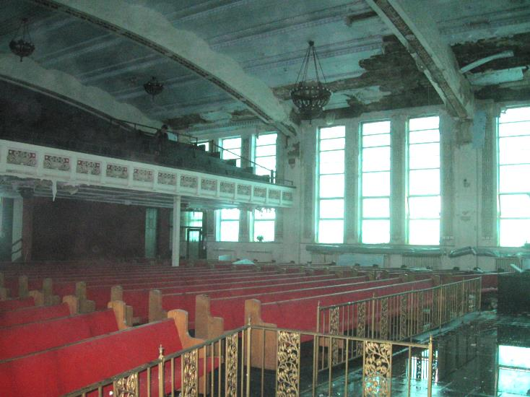
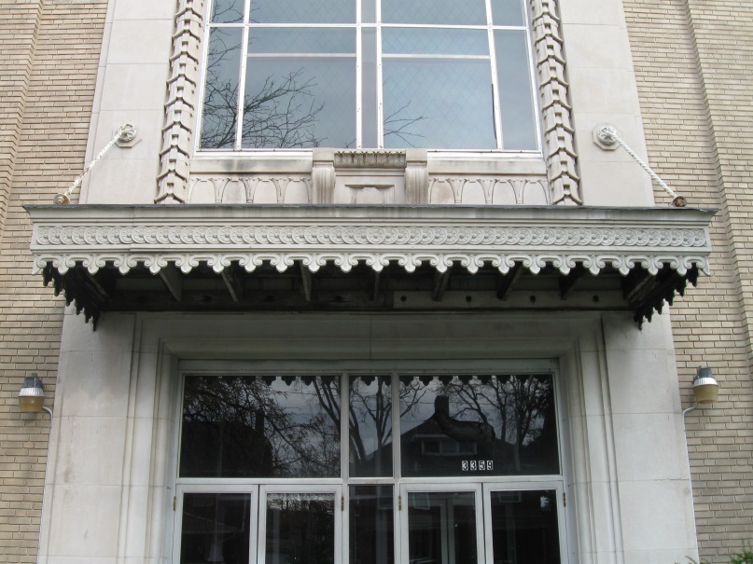
Summary an investment in the heart of Mapleton-Fall Creek
stabilize & preserve
community asset
Indiana Landmarks
City of Indianapolis
outreach to identify end-use
MFCDC is a trusted community partner
community benefits
$190K MFCDC unencumbered funding stream
renovated historic landmark building
new partnerships

Slide 13
Thank You! Temple Heritage Center, Inc.
Tyson Domer
tyson@hundredyear.net
Questions?

